Slide 1

Course Code: INT232
DATA SCIENCE TOOLBOX : R PROGRAMMING
www.lpu.in Lovely Professional University
1

Slide 2


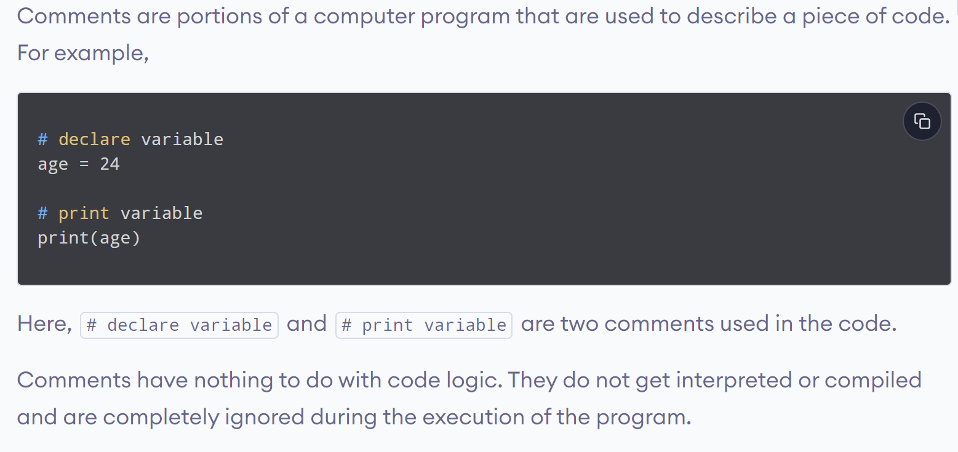
www.lpu.in Lovely Professional University
2

Slide 3
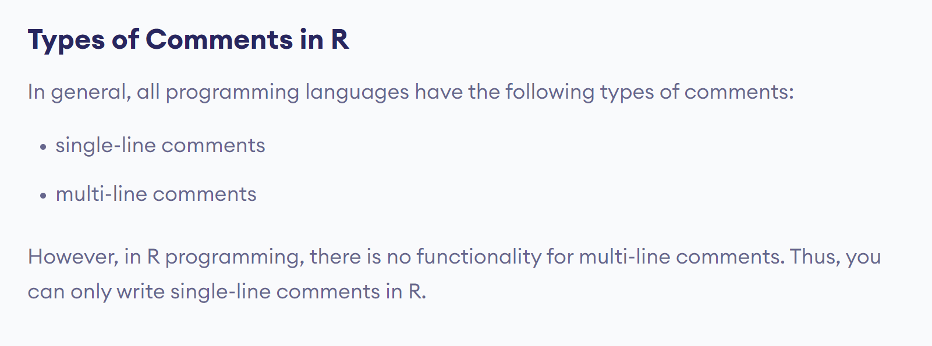
www.lpu.in Lovely Professional University
3

Slide 4
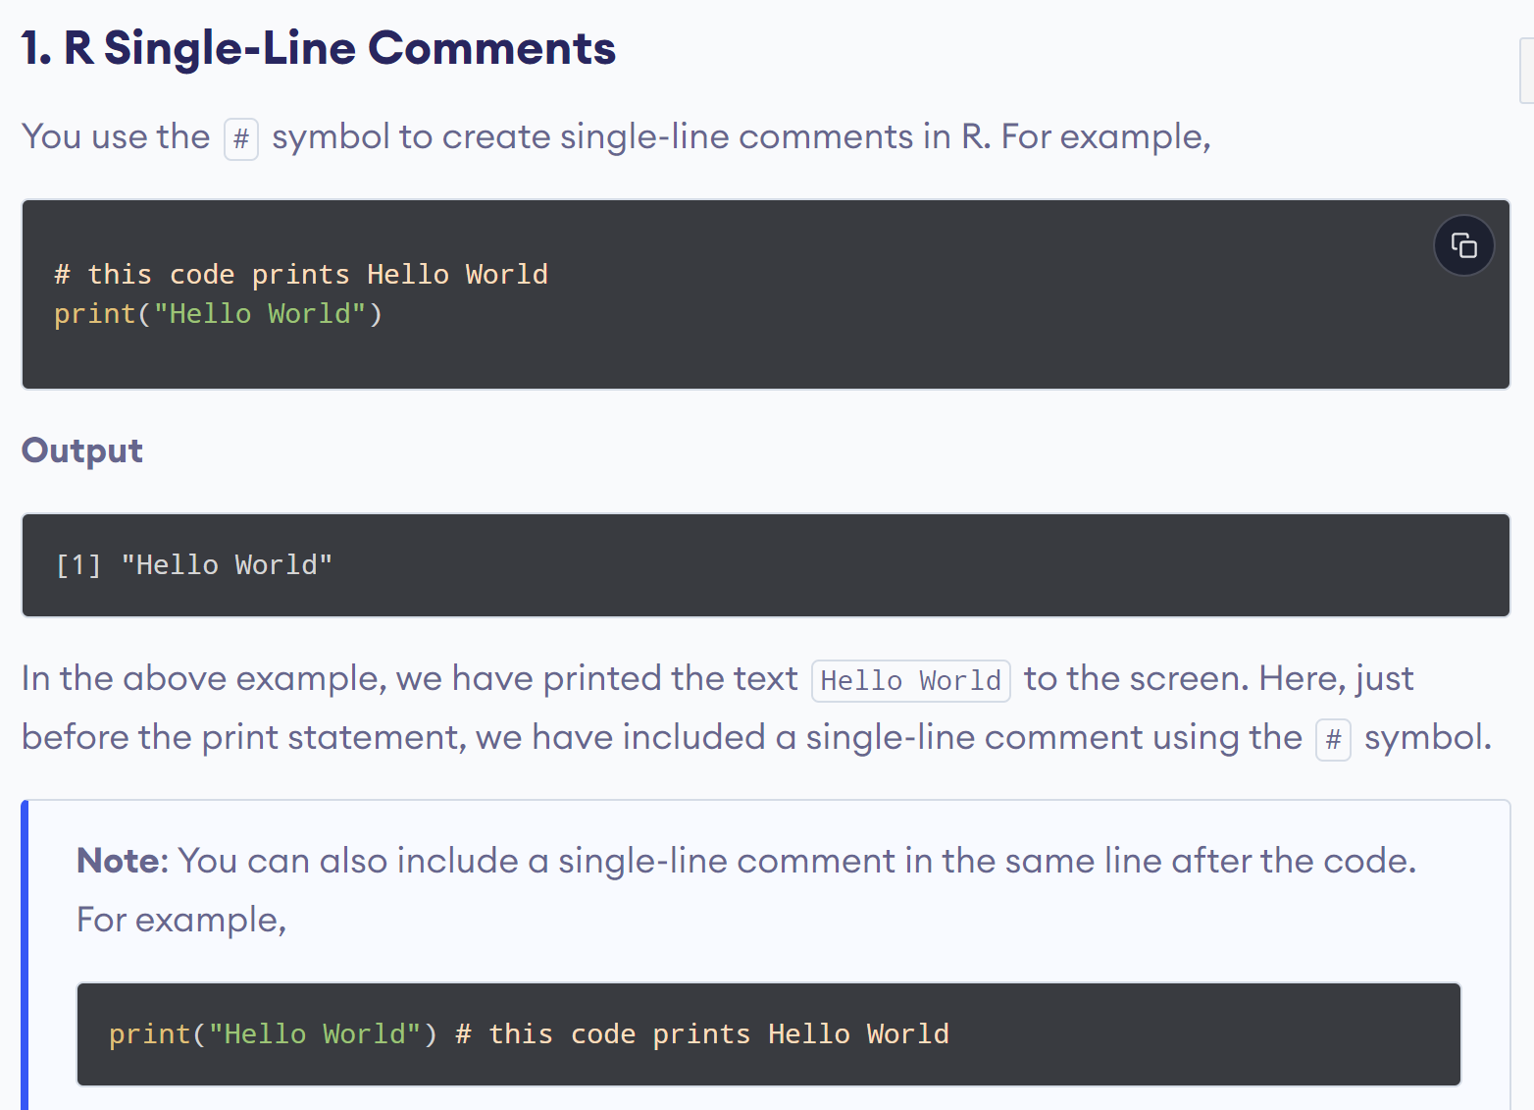
www.lpu.in Lovely Professional University
4

Slide 5
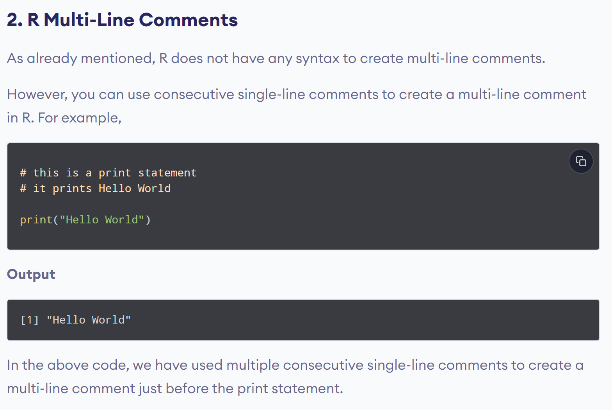
www.lpu.in Lovely Professional University
5

Slide 6
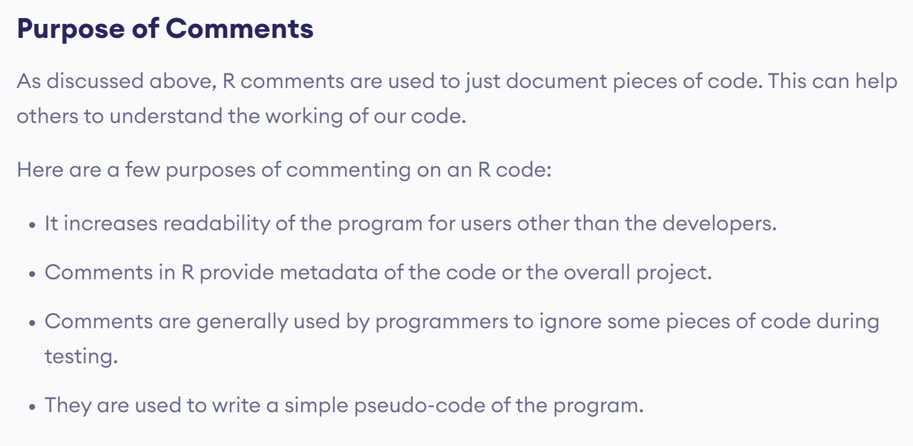
www.lpu.in Lovely Professional University
6

Slide 7
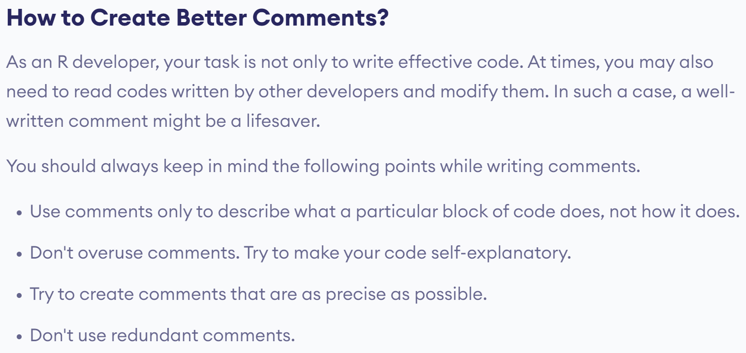
www.lpu.in Lovely Professional University
7

Slide 8

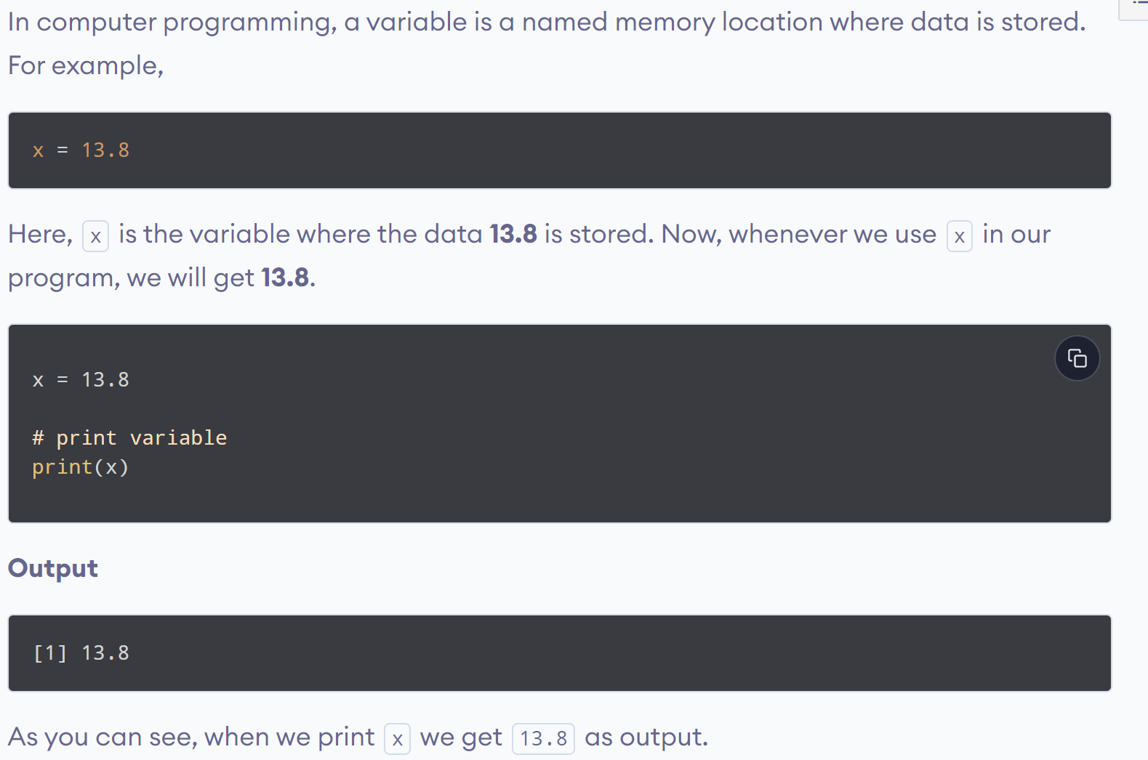
www.lpu.in Lovely Professional University
8

Slide 9
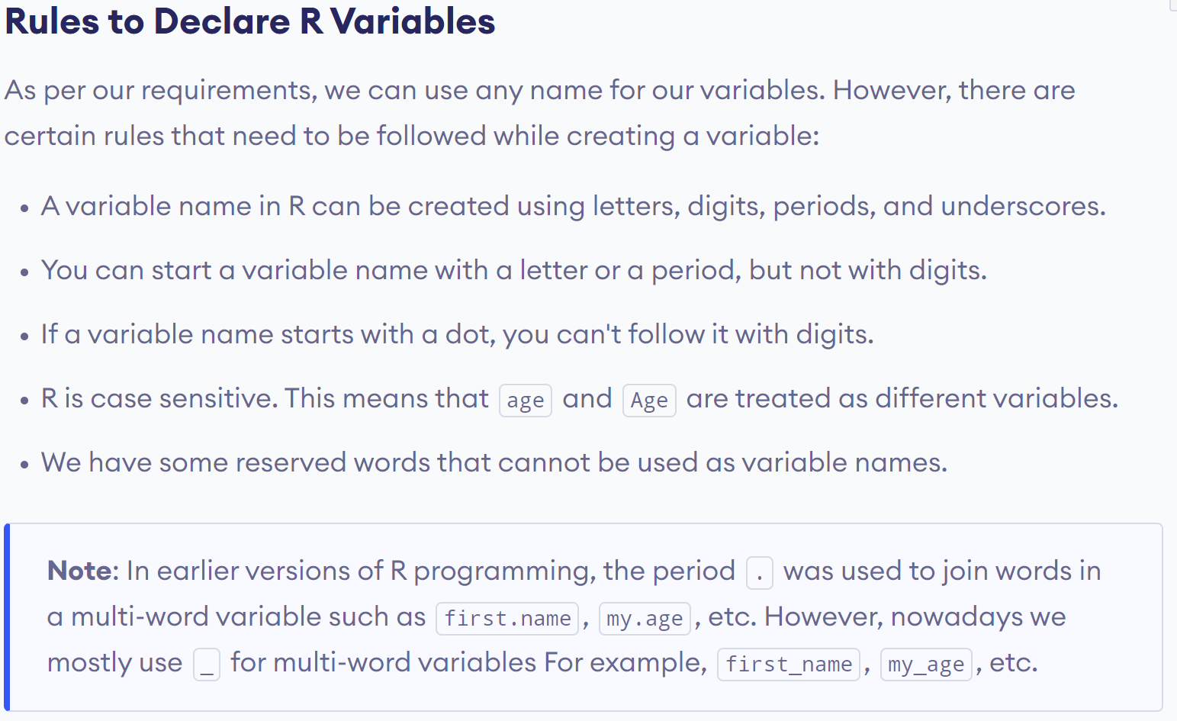
www.lpu.in Lovely Professional University
9

Slide 10
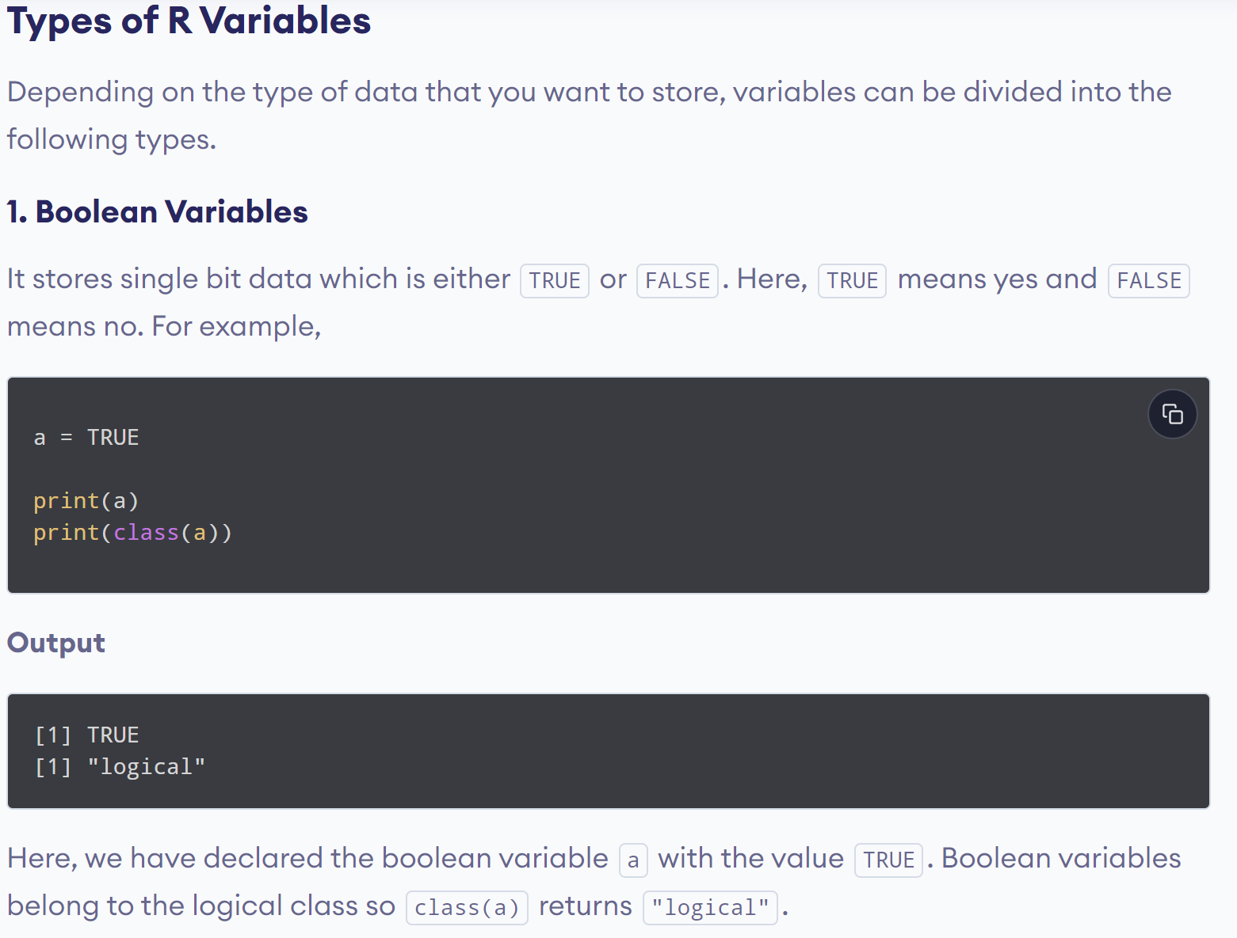
www.lpu.in Lovely Professional University
10

Slide 11
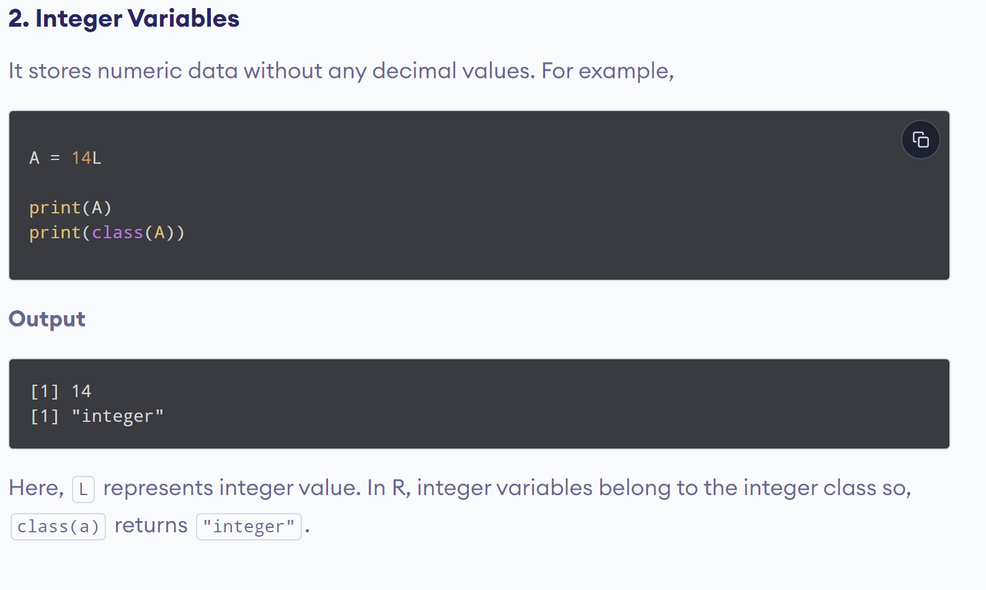
www.lpu.in Lovely Professional University
11

Slide 12
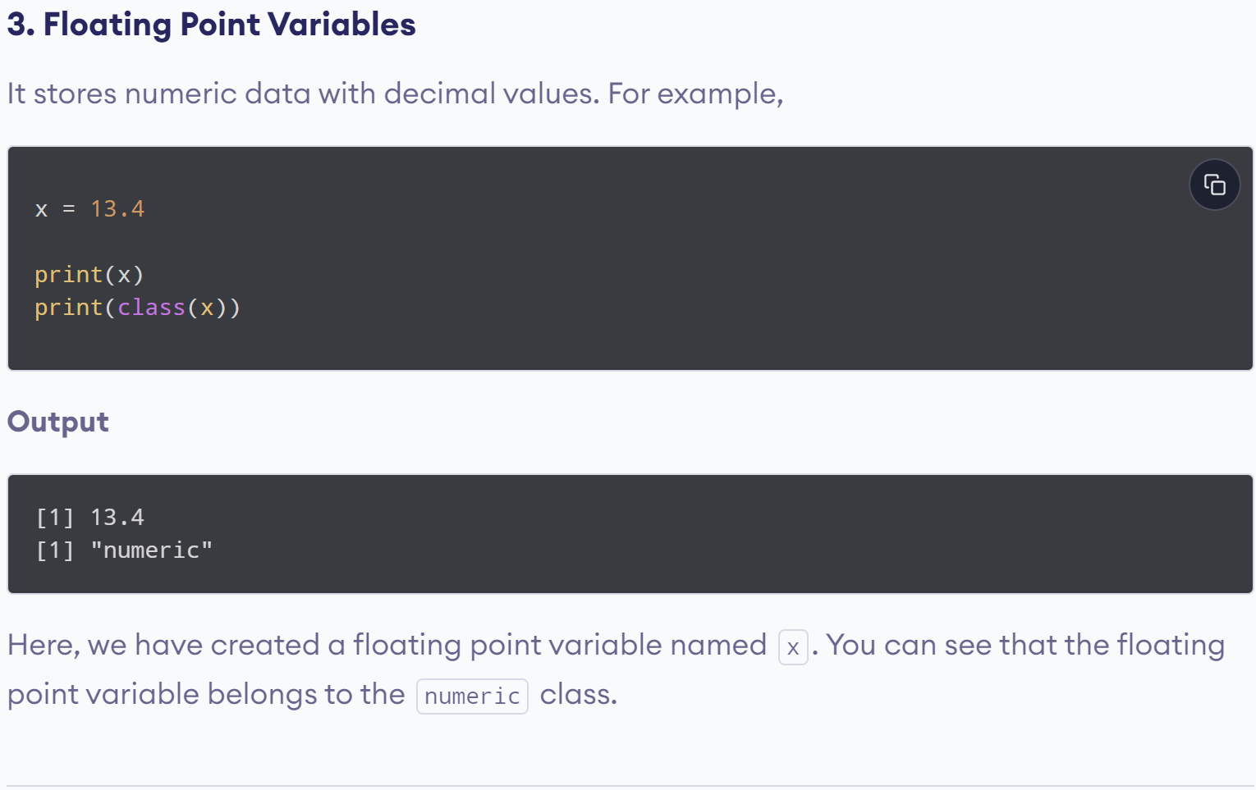
www.lpu.in Lovely Professional University
12

Slide 13
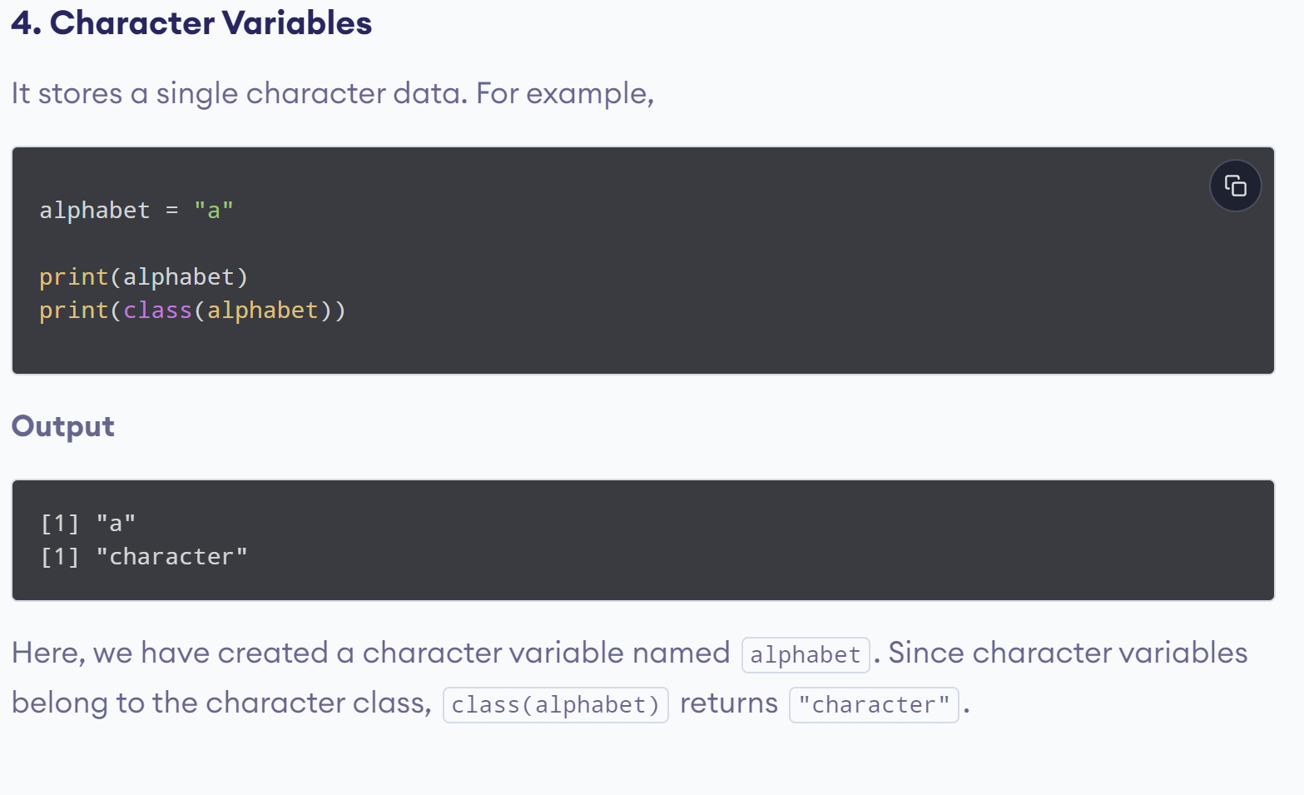
www.lpu.in Lovely Professional University
13

Slide 14
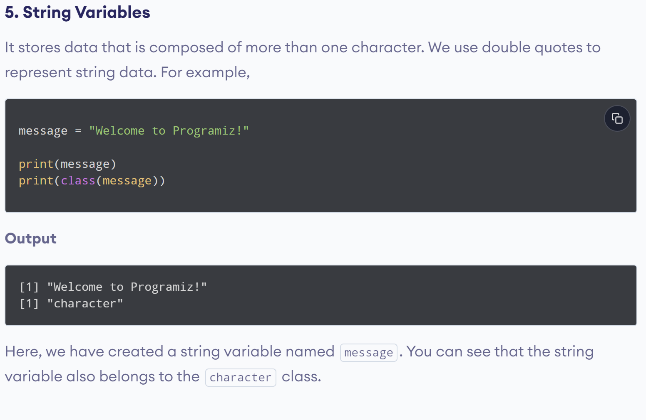
www.lpu.in Lovely Professional University
14

Slide 15
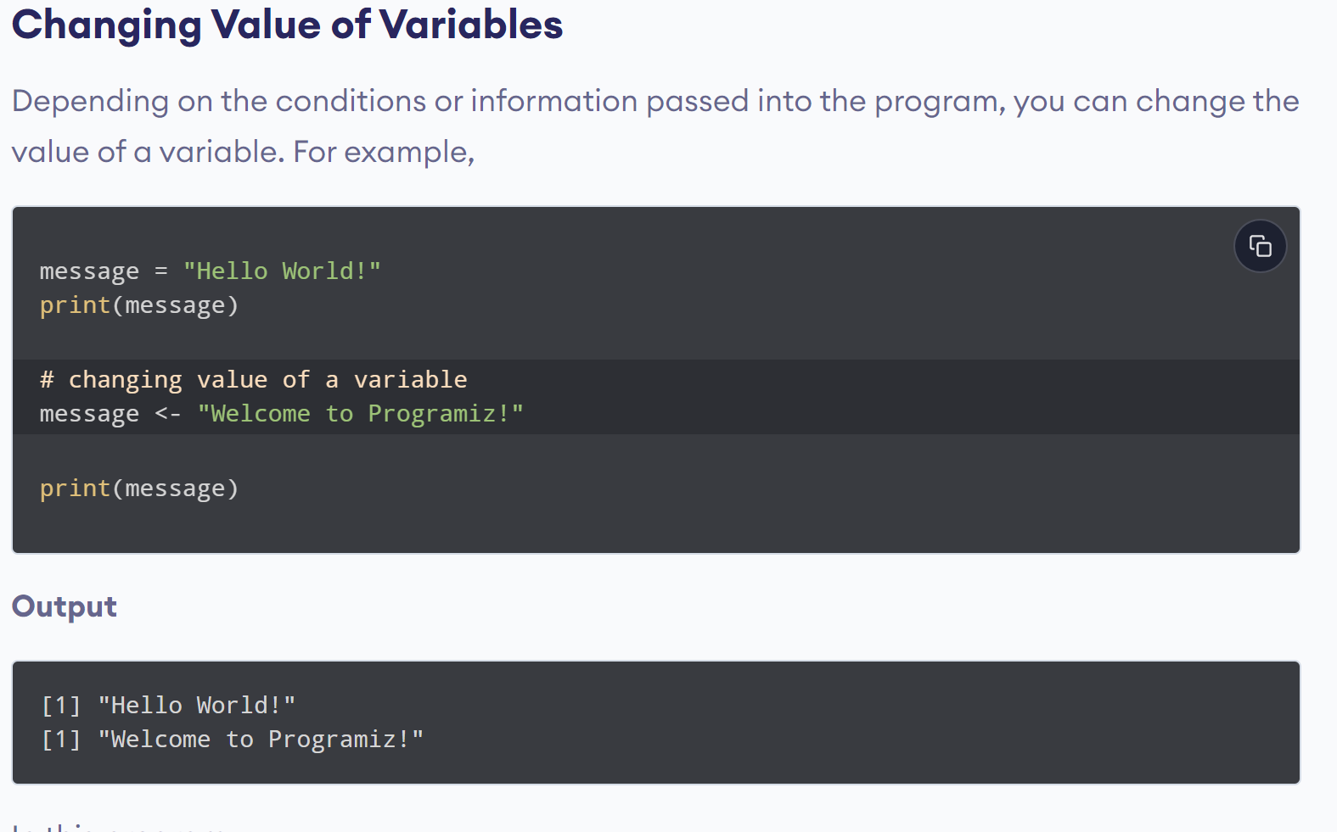
www.lpu.in Lovely Professional University
15

Slide 16
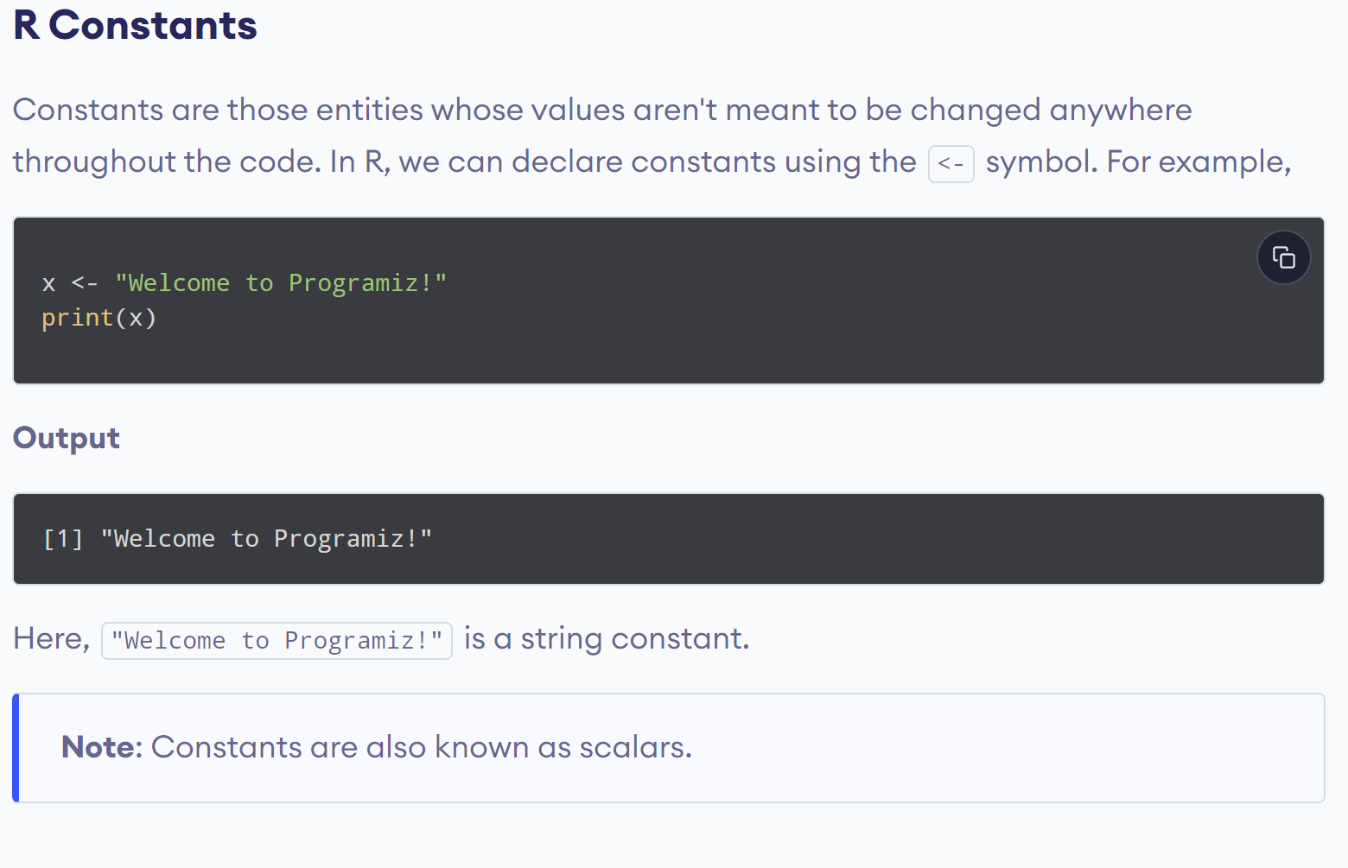
www.lpu.in Lovely Professional University
16

Slide 17
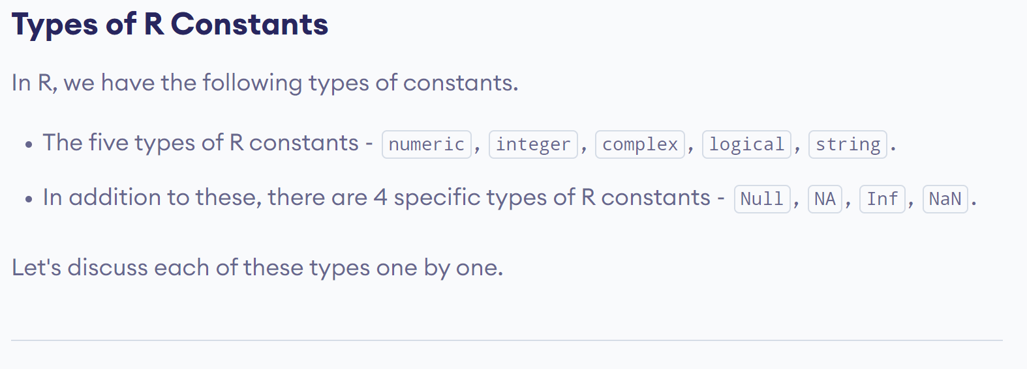
www.lpu.in Lovely Professional University
17

Slide 18
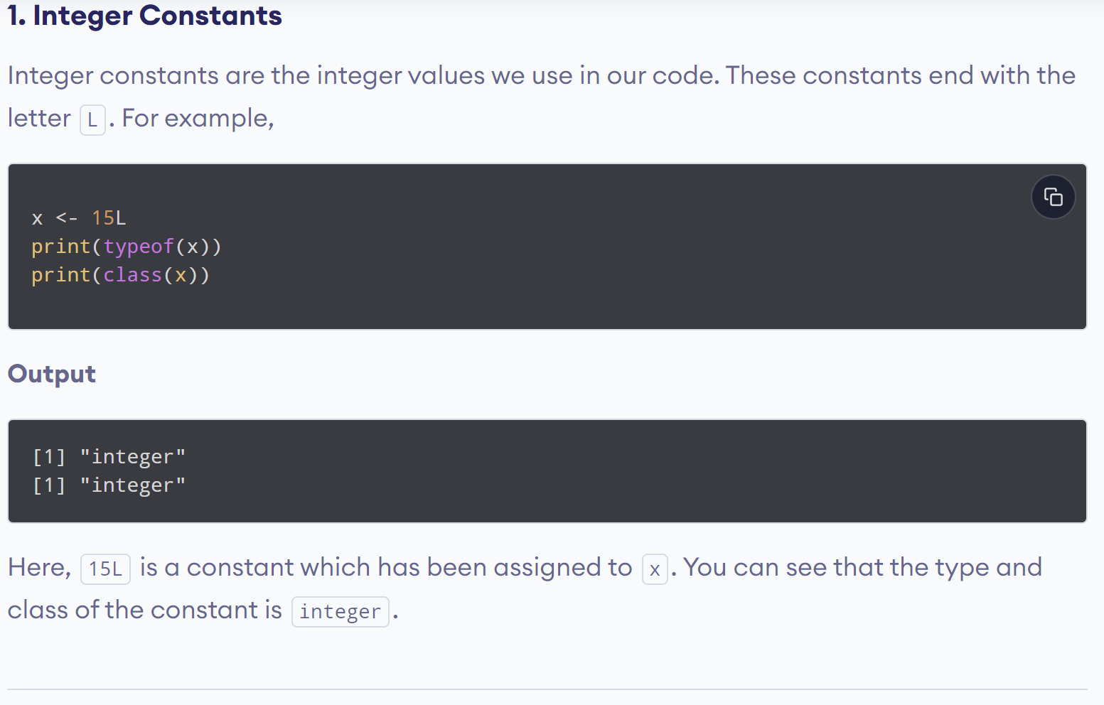
www.lpu.in Lovely Professional University
18

Slide 19
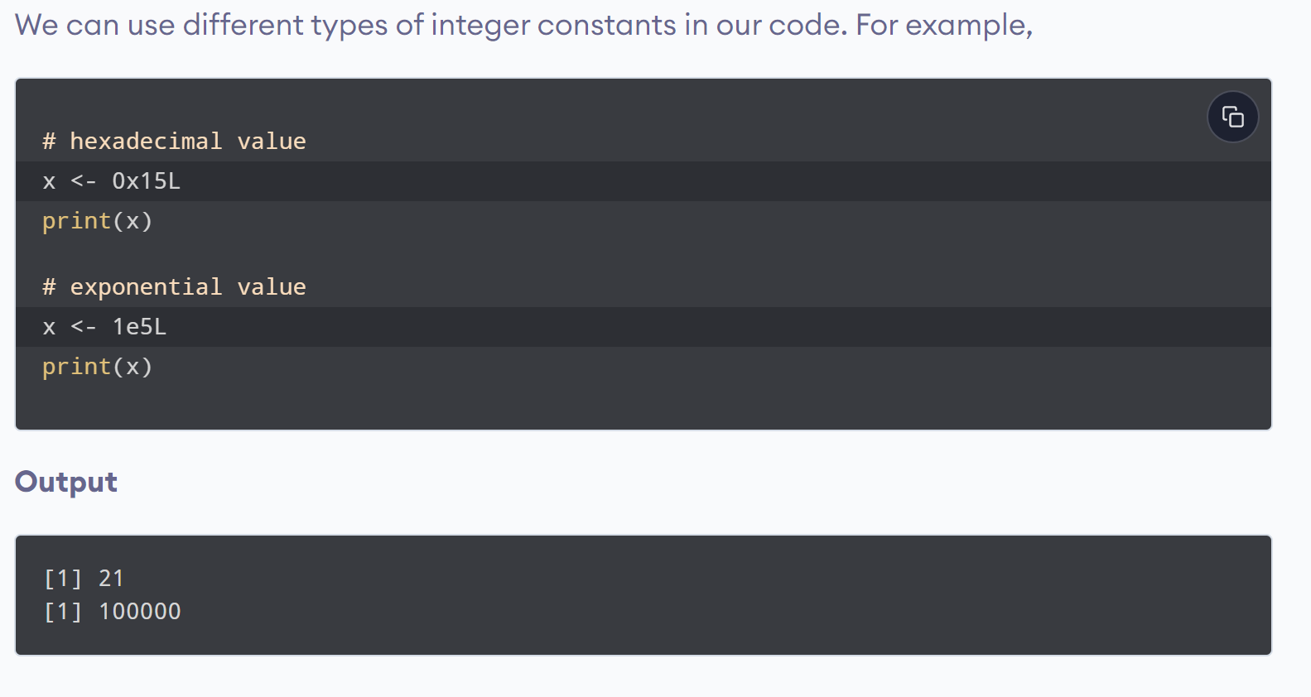
www.lpu.in Lovely Professional University
19

Slide 20
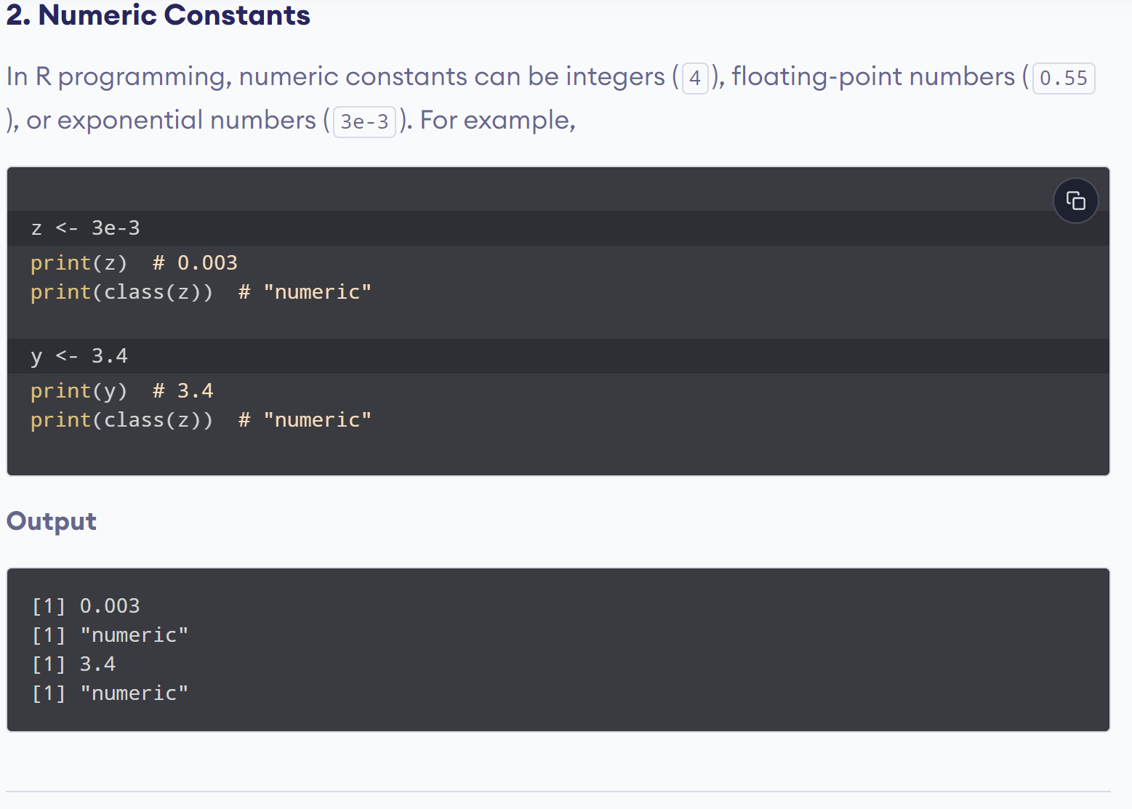
www.lpu.in Lovely Professional University
20

Slide 21
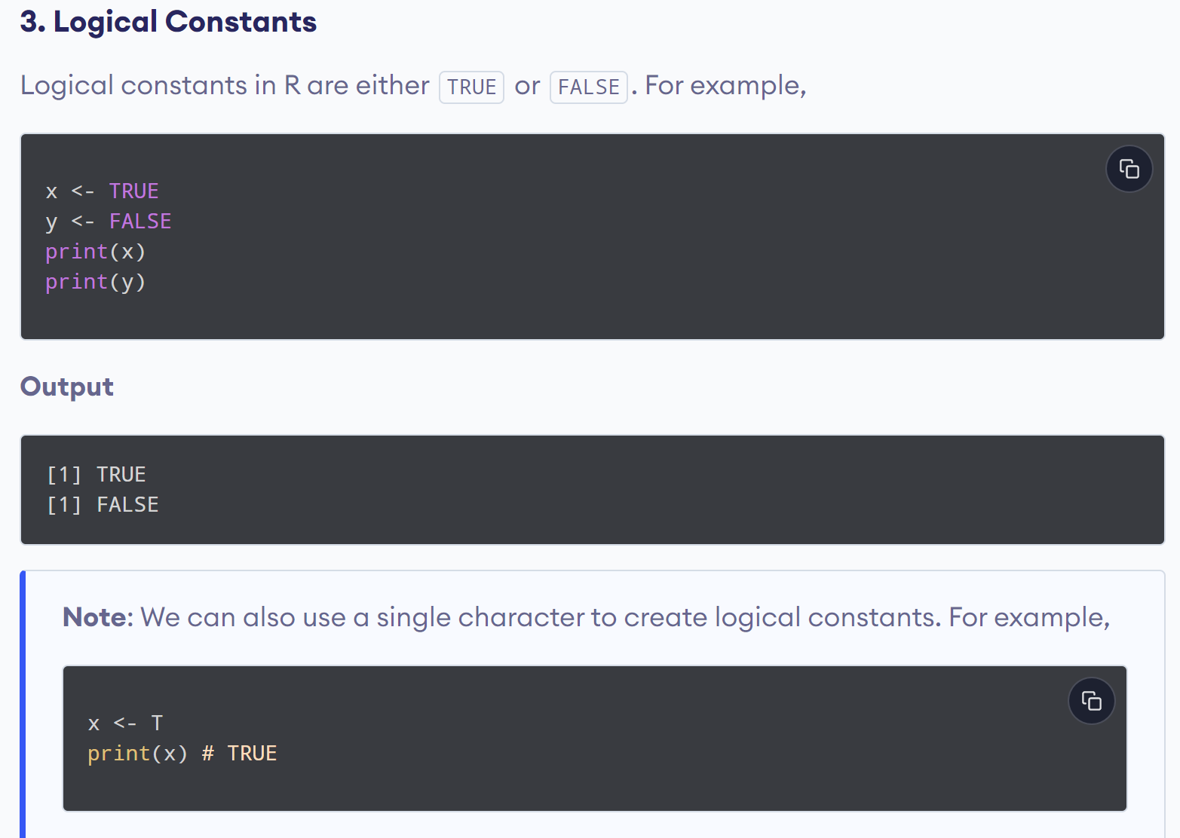
www.lpu.in Lovely Professional University
21

Slide 22
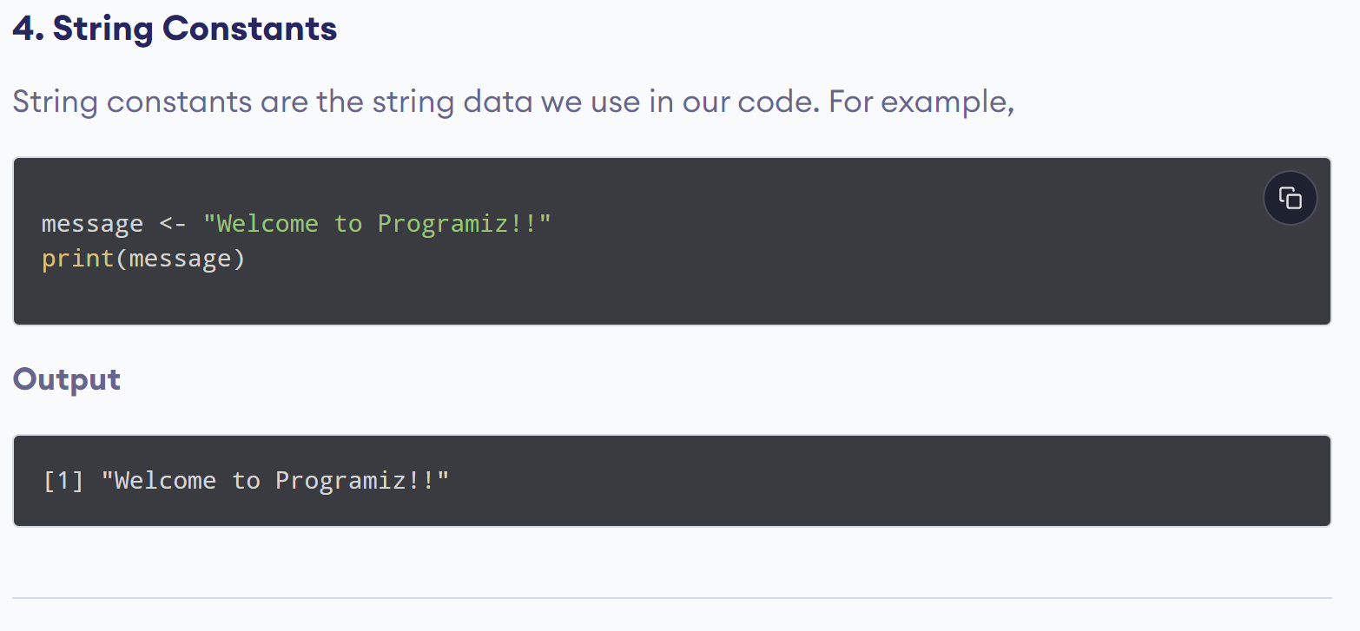
www.lpu.in Lovely Professional University
22

Slide 23
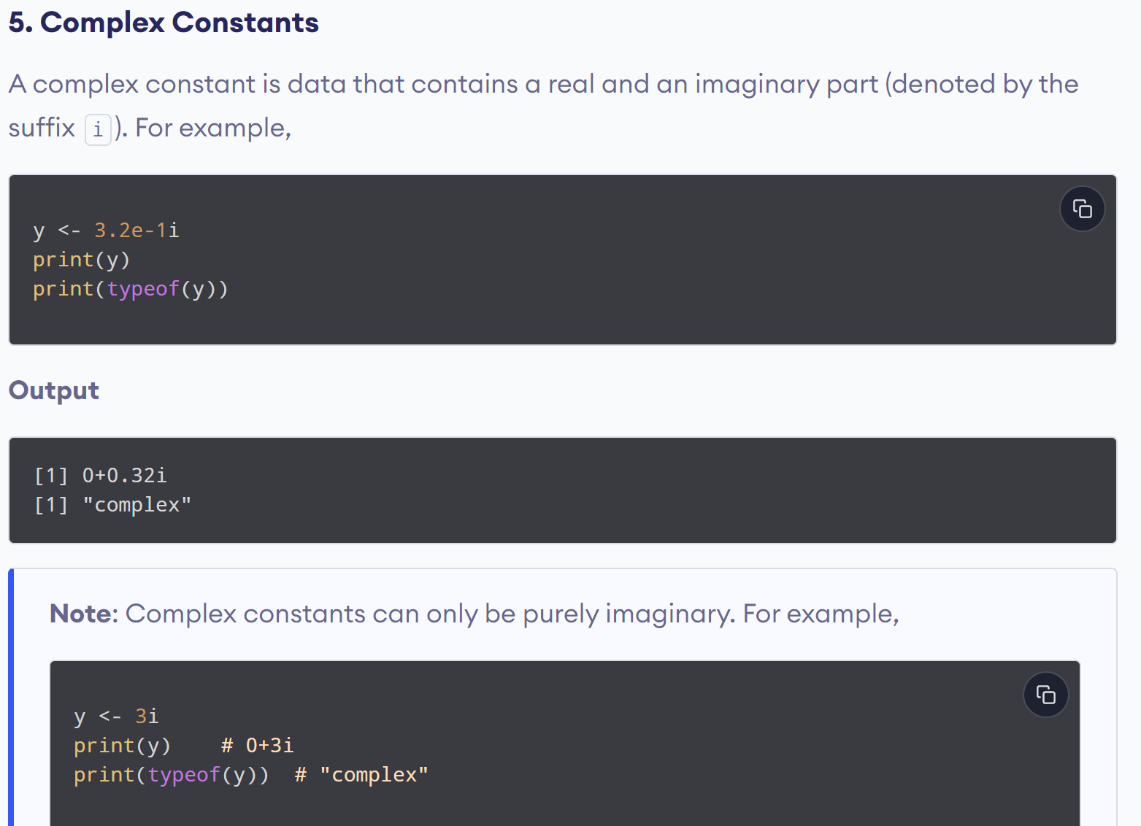
www.lpu.in Lovely Professional University
23

Slide 24
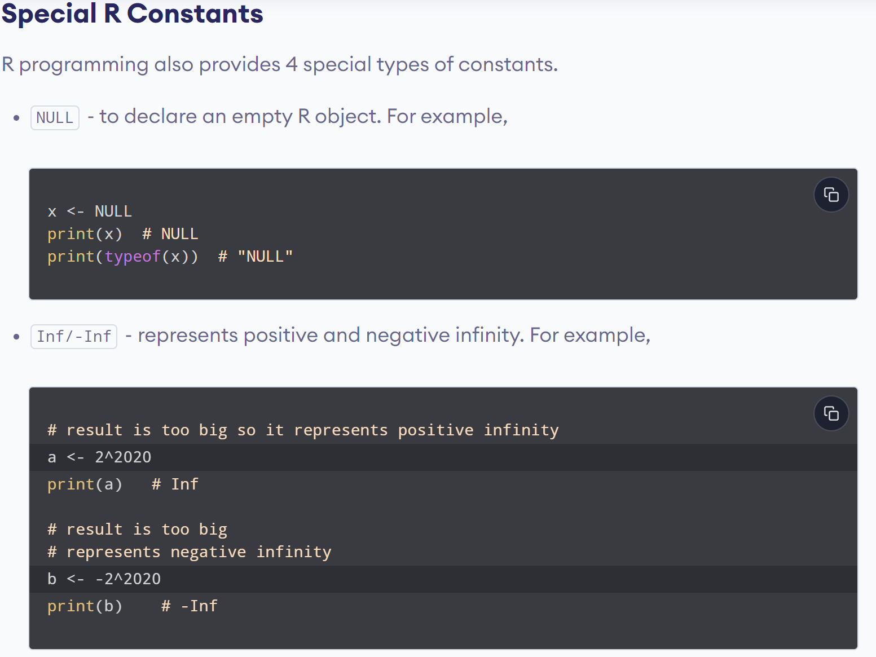
www.lpu.in Lovely Professional University
24

Slide 25
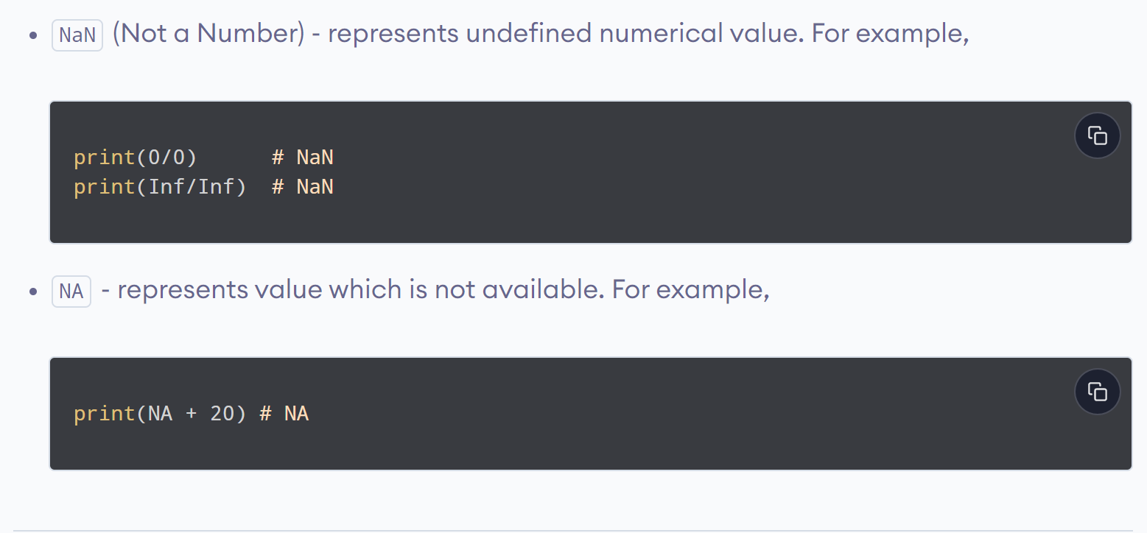
www.lpu.in Lovely Professional University
25

Slide 26
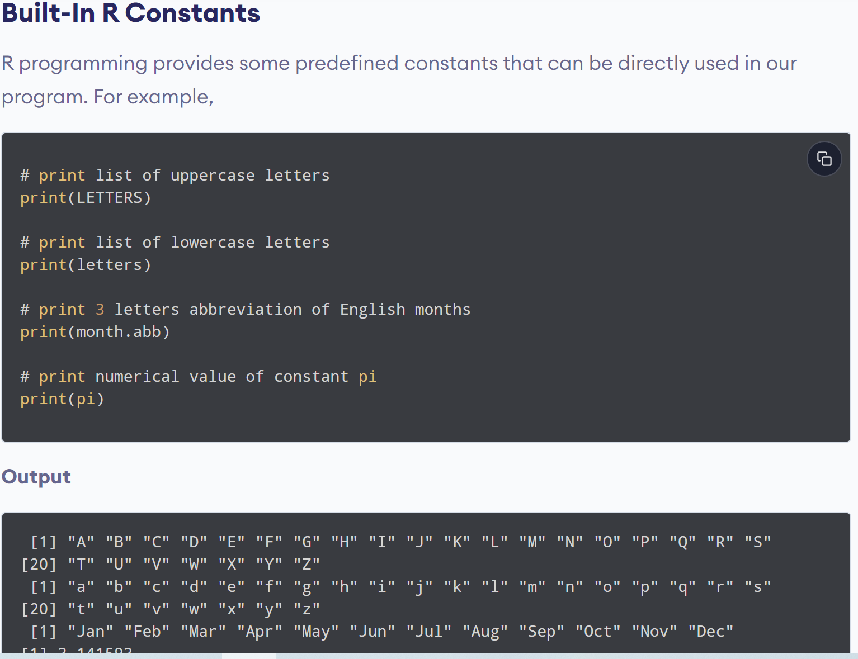
www.lpu.in Lovely Professional University
26

Slide 27
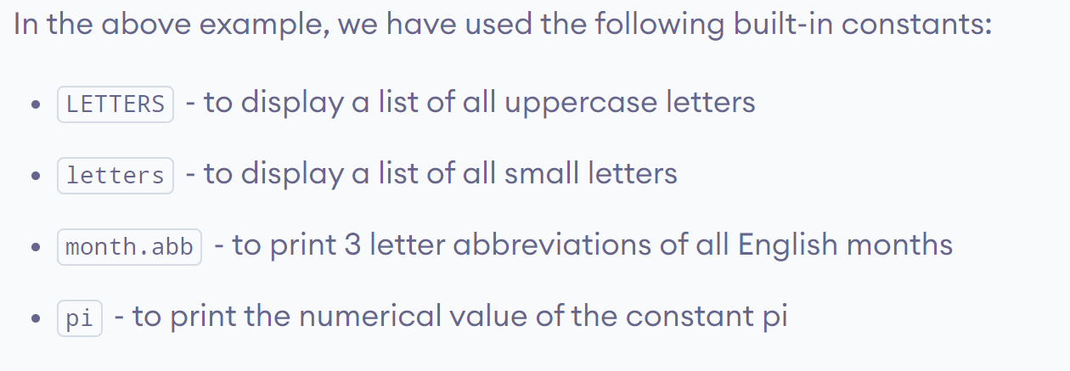
www.lpu.in Lovely Professional University
27

Slide 28

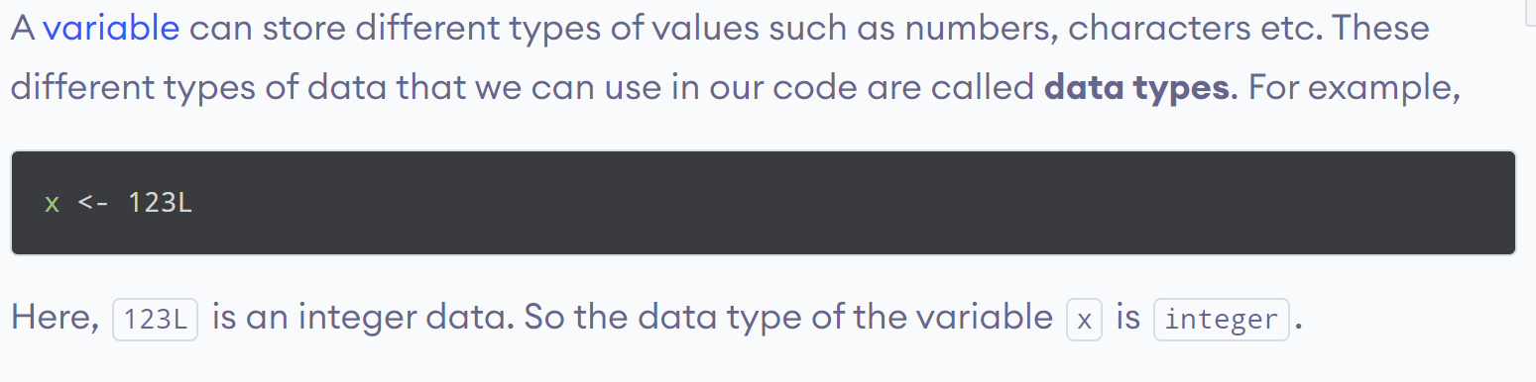
www.lpu.in Lovely Professional University
28

Slide 29
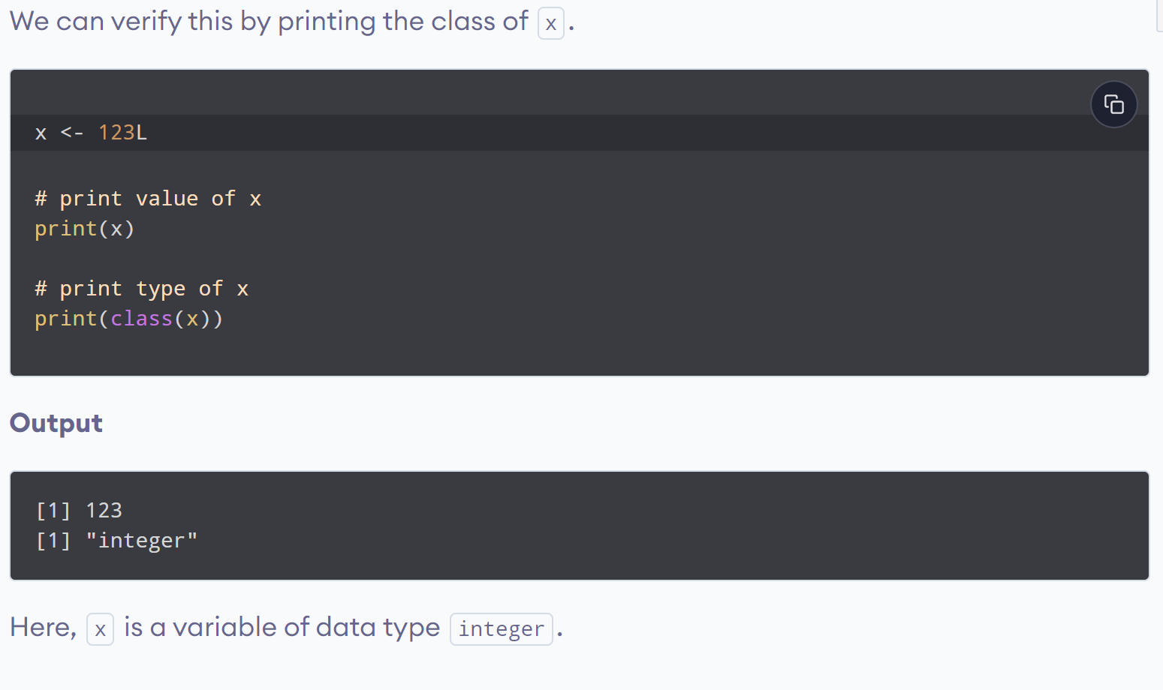
www.lpu.in Lovely Professional University
29

Slide 30
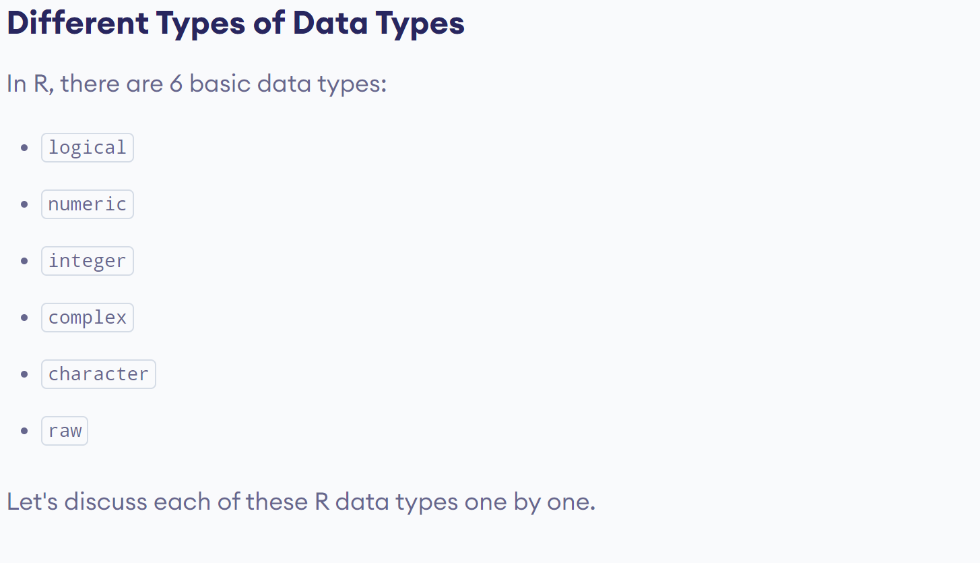
www.lpu.in Lovely Professional University
30

Slide 31
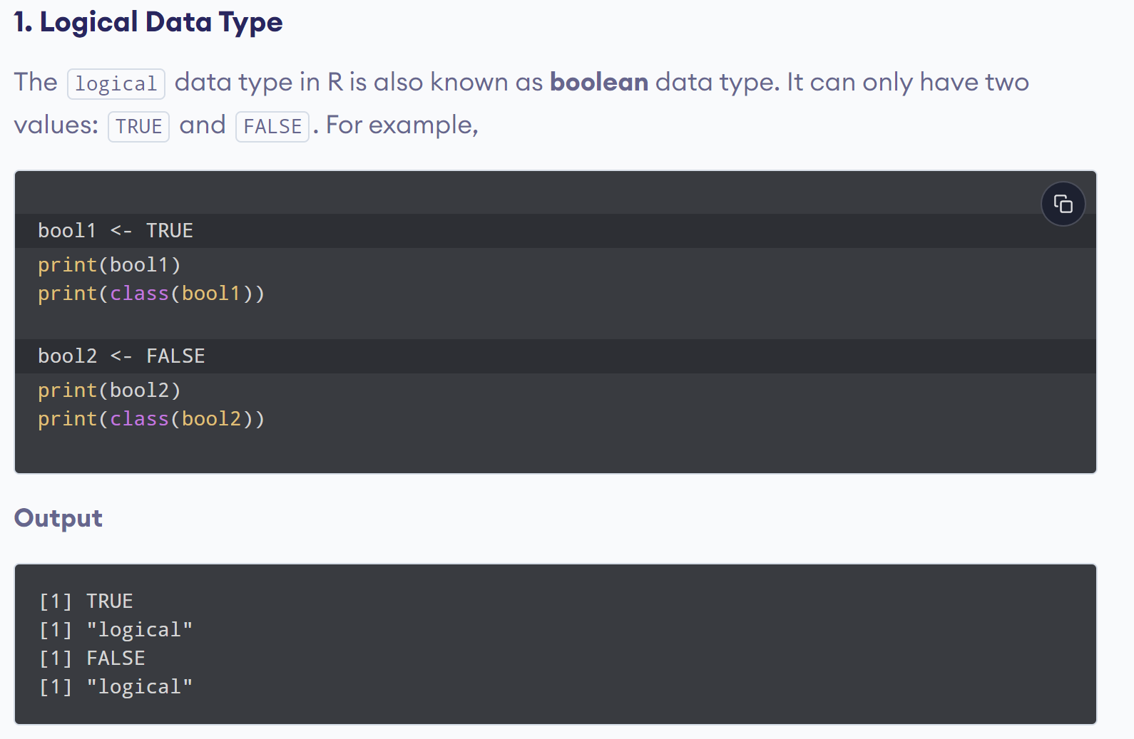
www.lpu.in Lovely Professional University
31

Slide 32
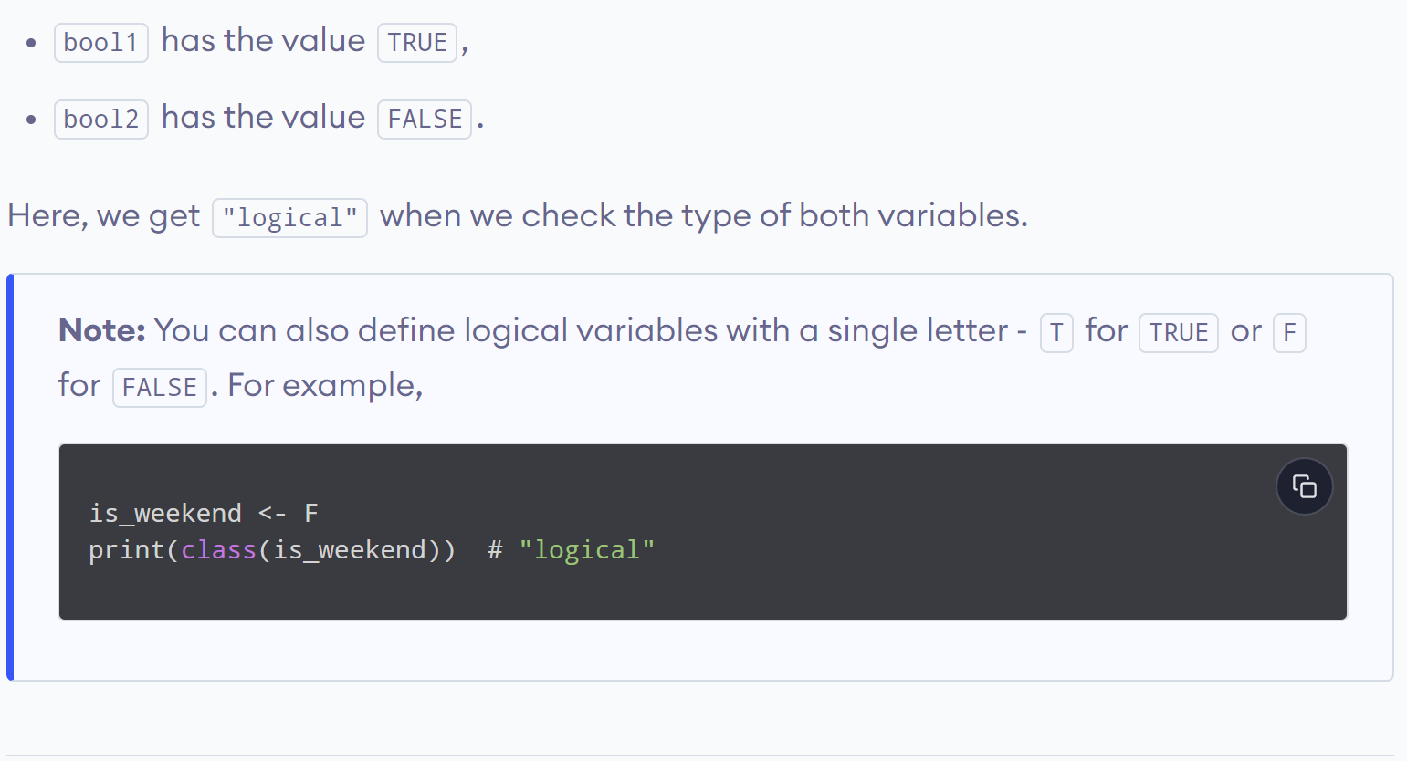
www.lpu.in Lovely Professional University
32

Slide 33
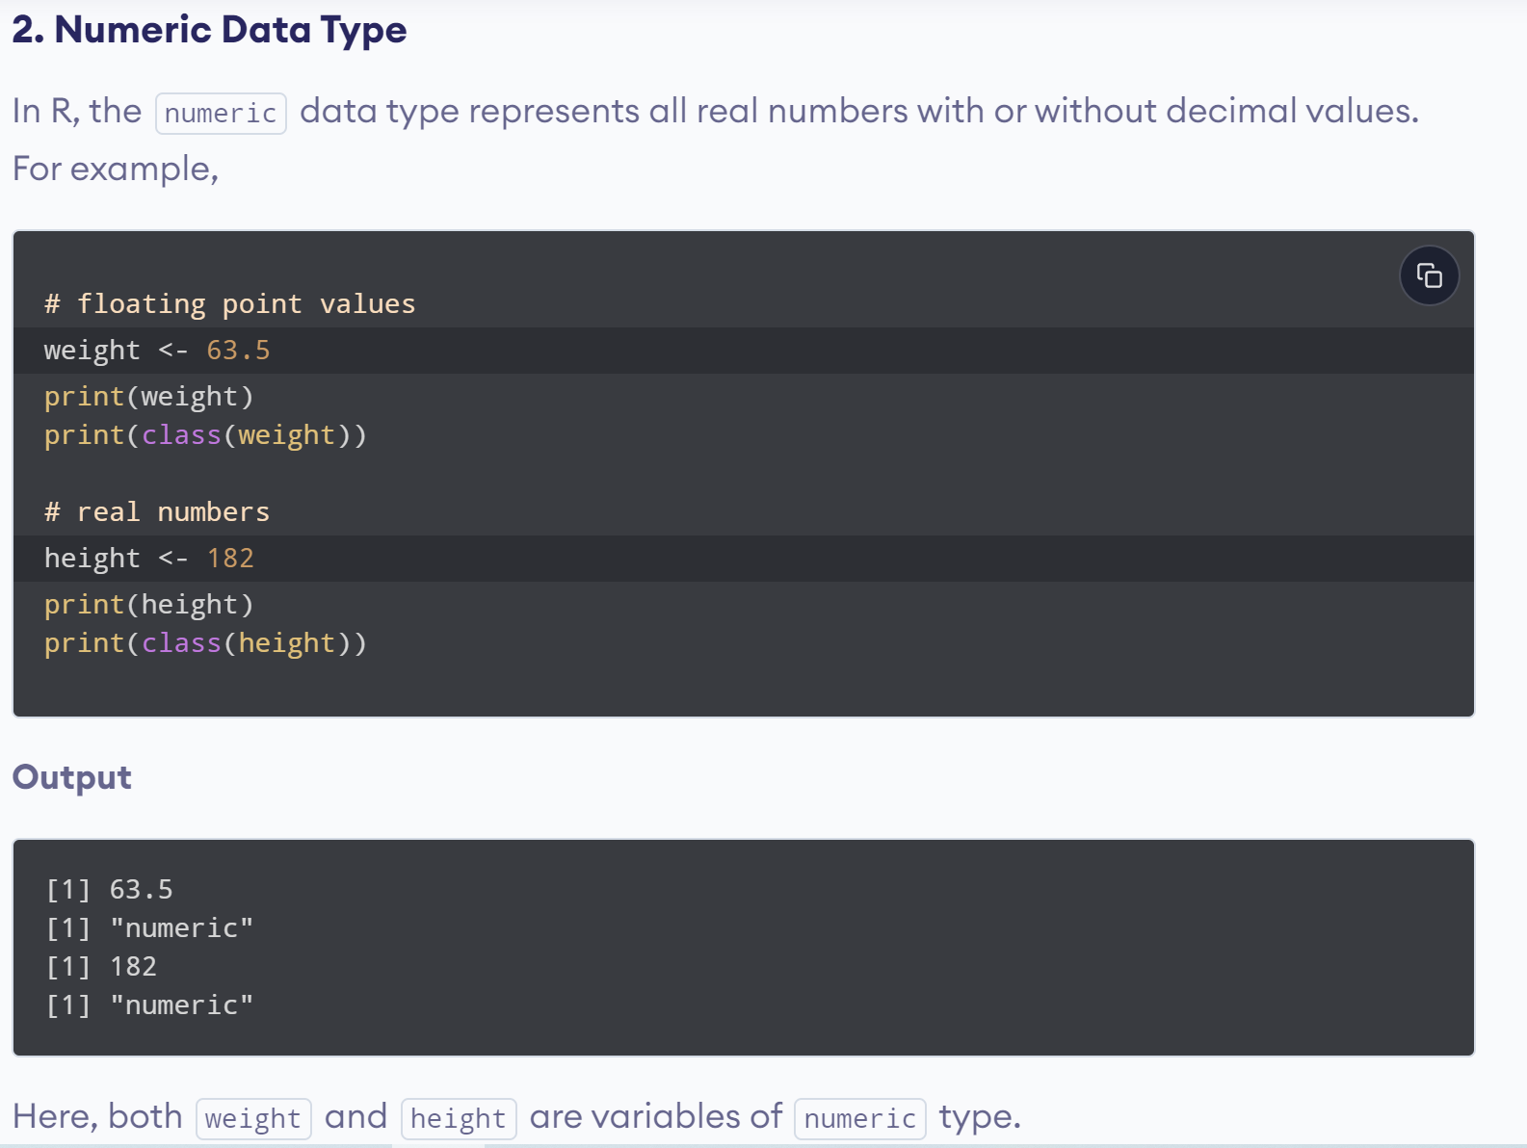
www.lpu.in Lovely Professional University
33

Slide 34
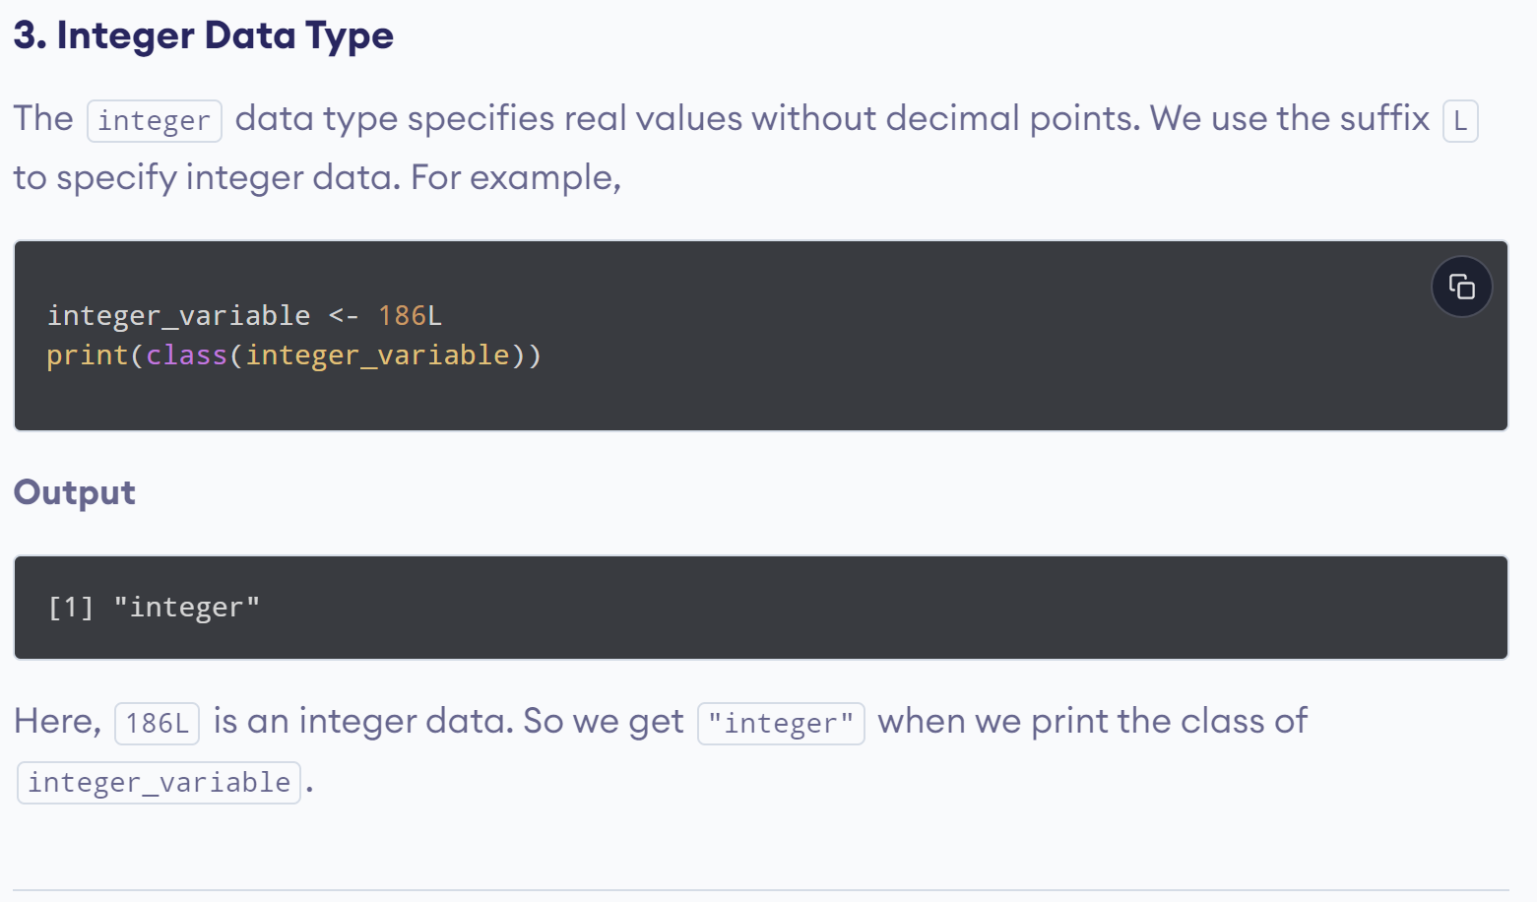
www.lpu.in Lovely Professional University
34

Slide 35
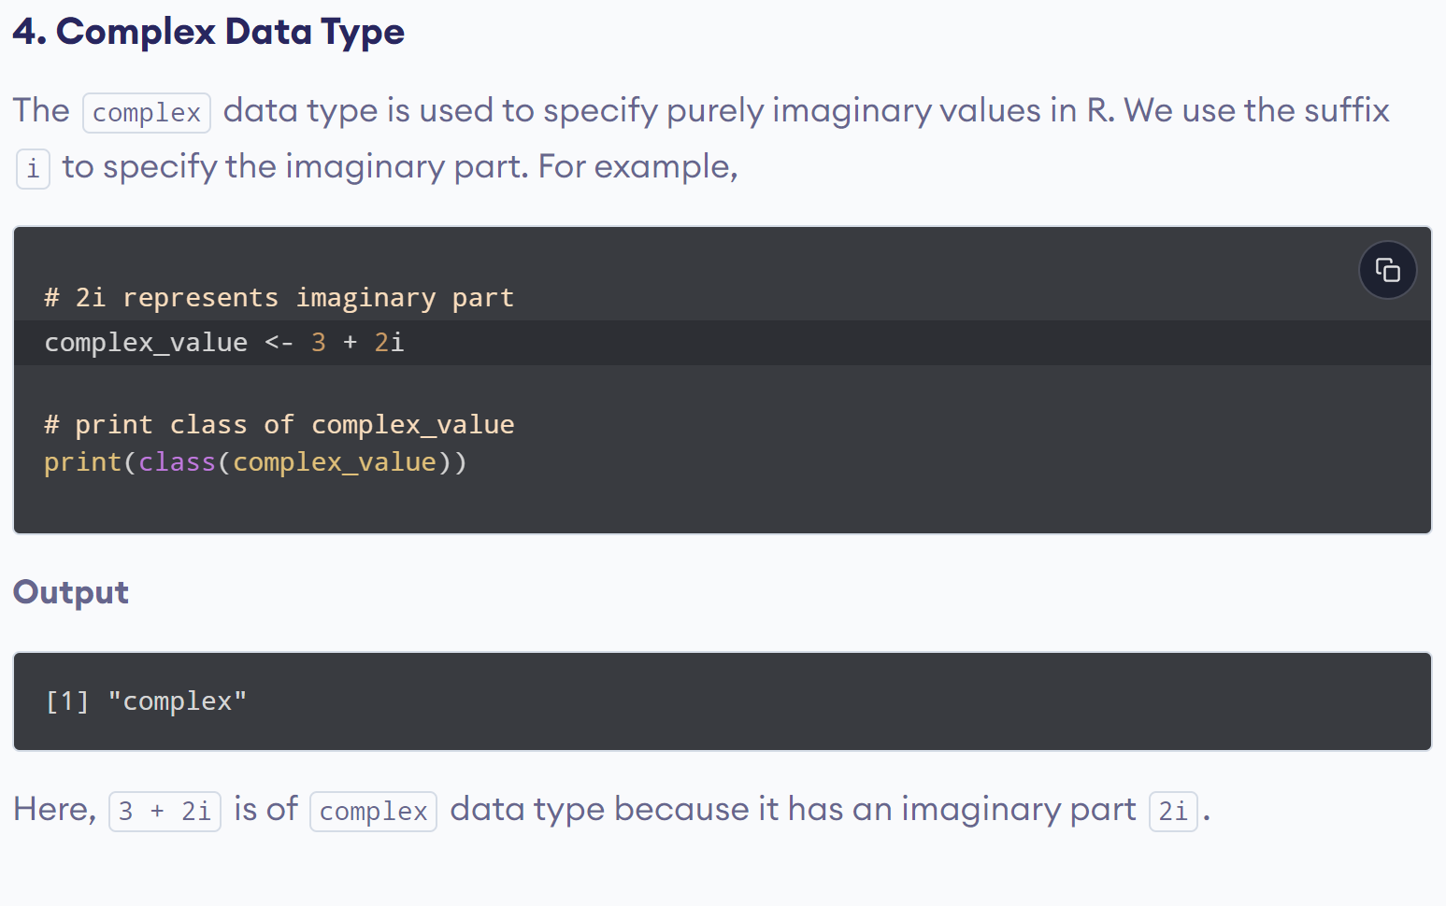
www.lpu.in Lovely Professional University
35

Slide 36
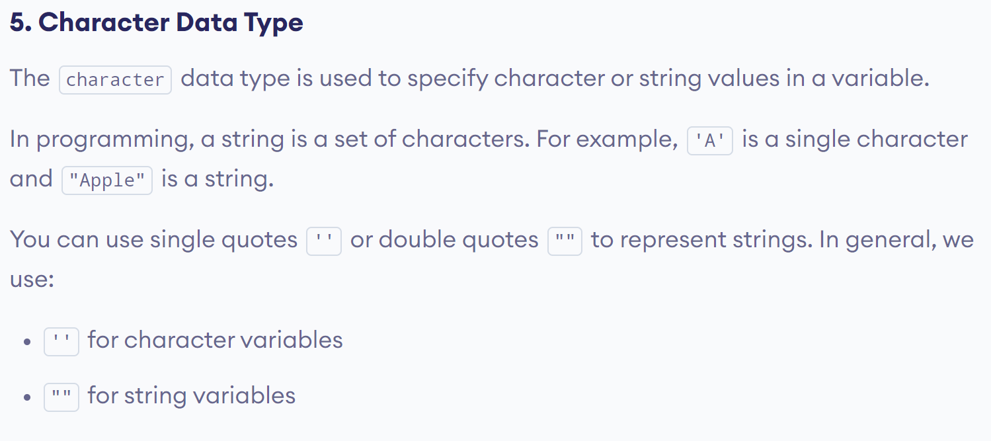
www.lpu.in Lovely Professional University
36

Slide 37
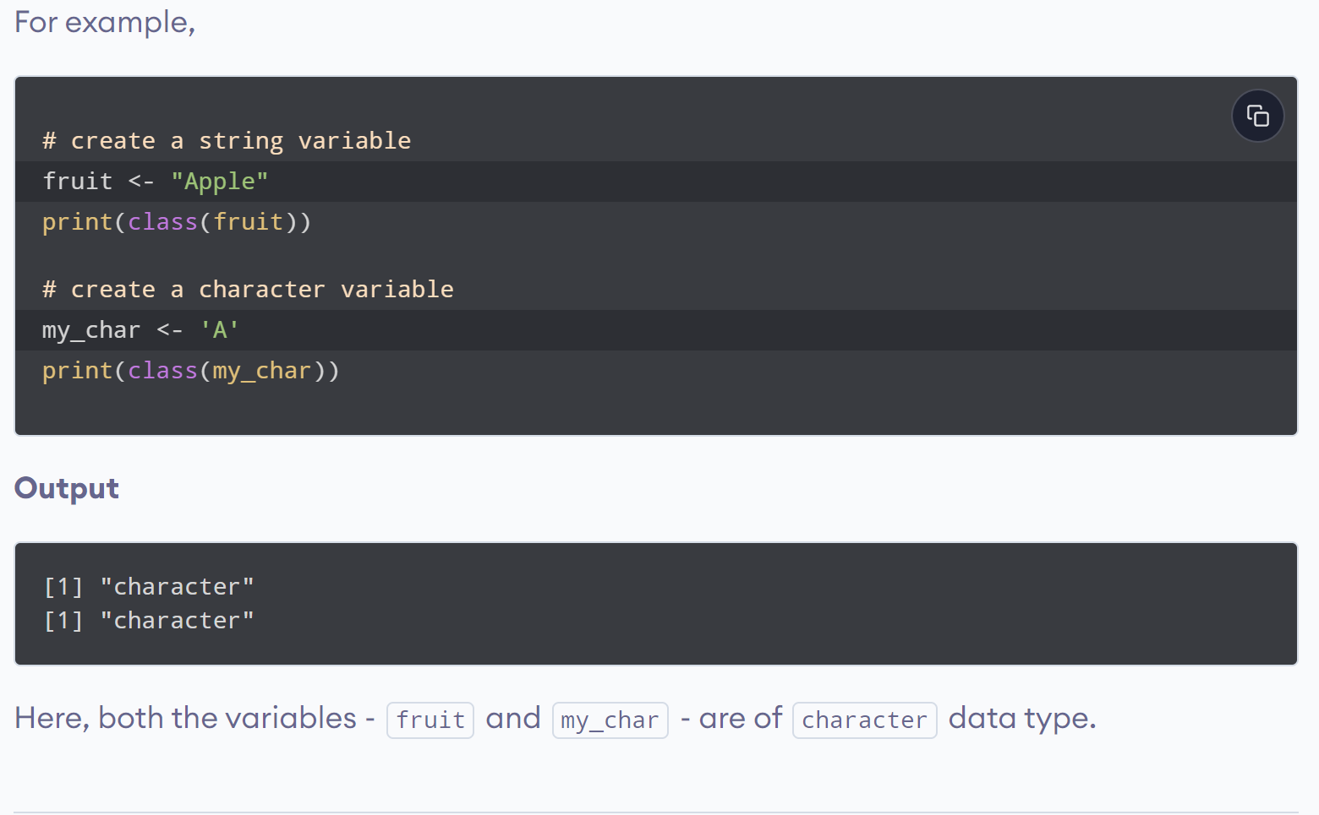
www.lpu.in Lovely Professional University
37

Slide 38
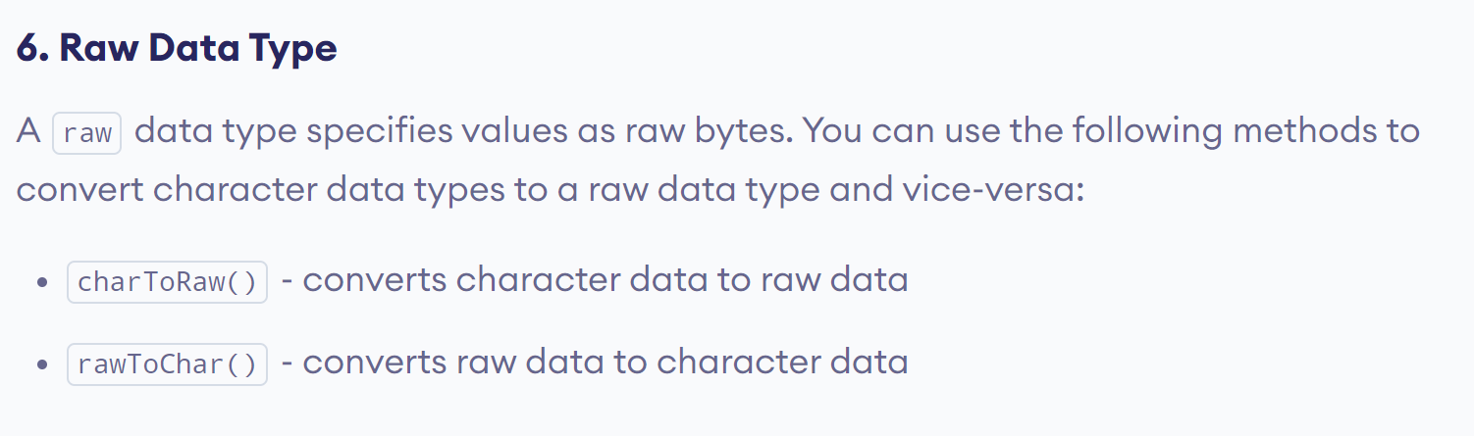
www.lpu.in Lovely Professional University
38

Slide 39
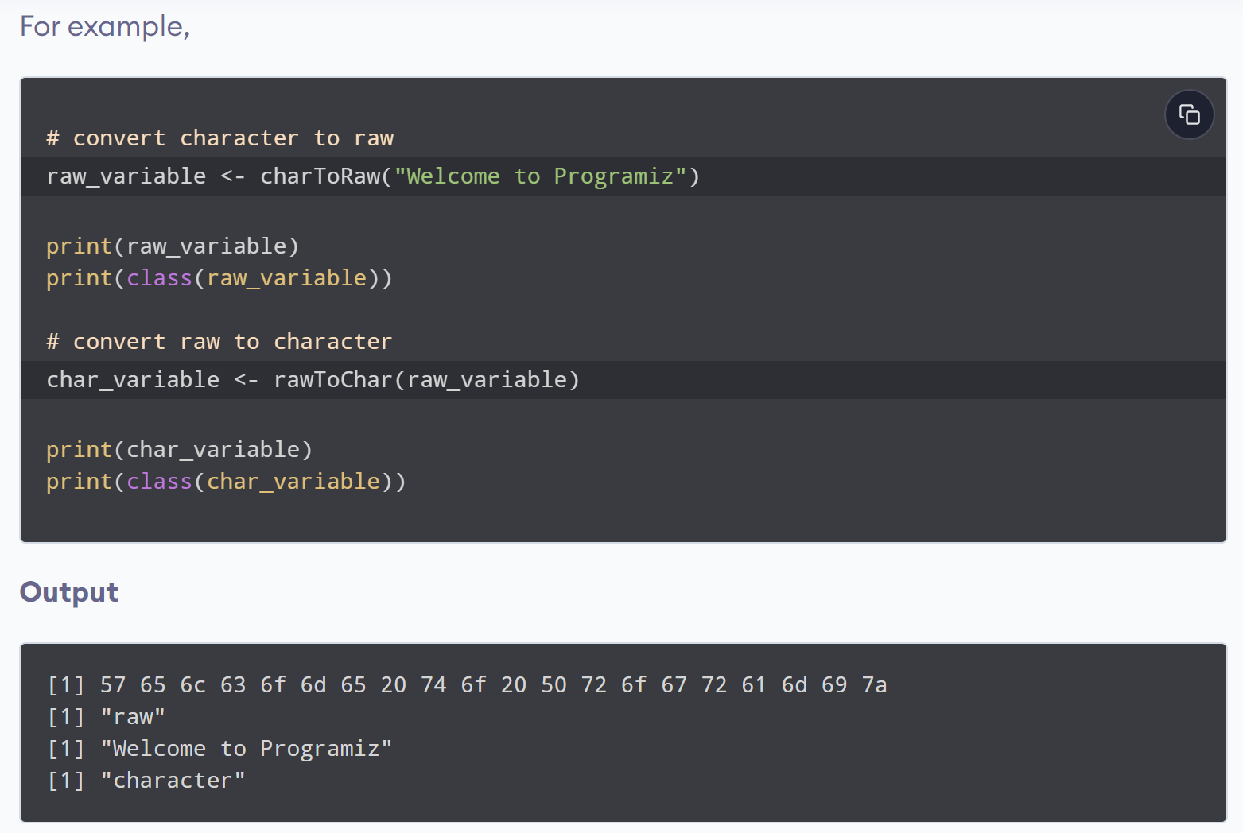
www.lpu.in Lovely Professional University
39

Slide 40
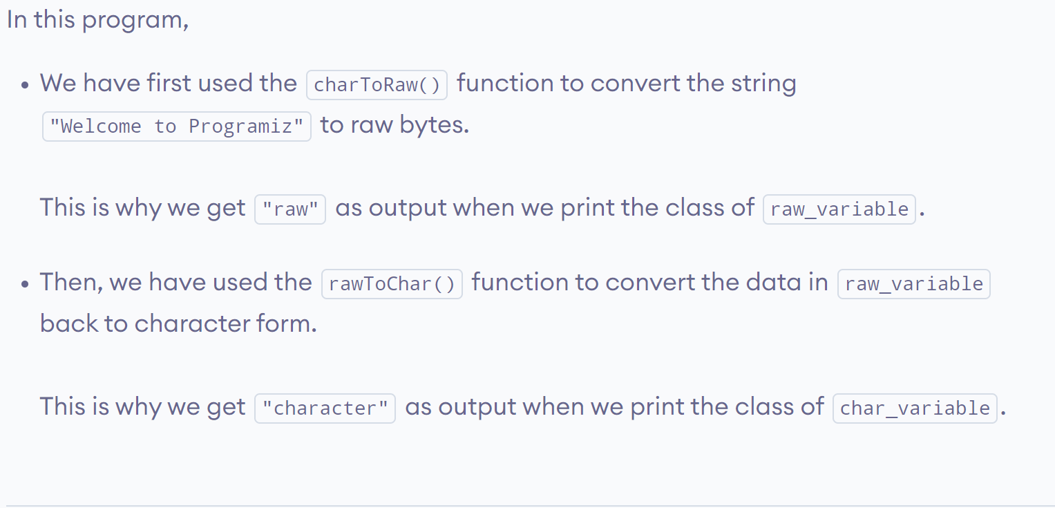
www.lpu.in Lovely Professional University
40

Slide 41

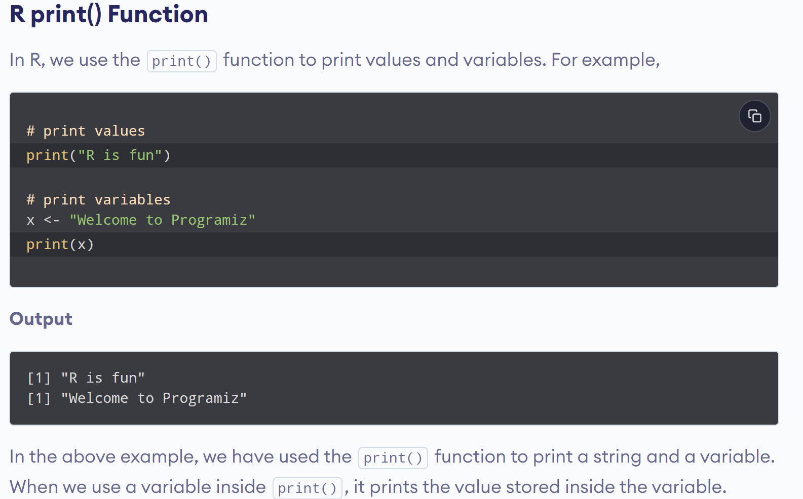
www.lpu.in Lovely Professional University
41

Slide 42
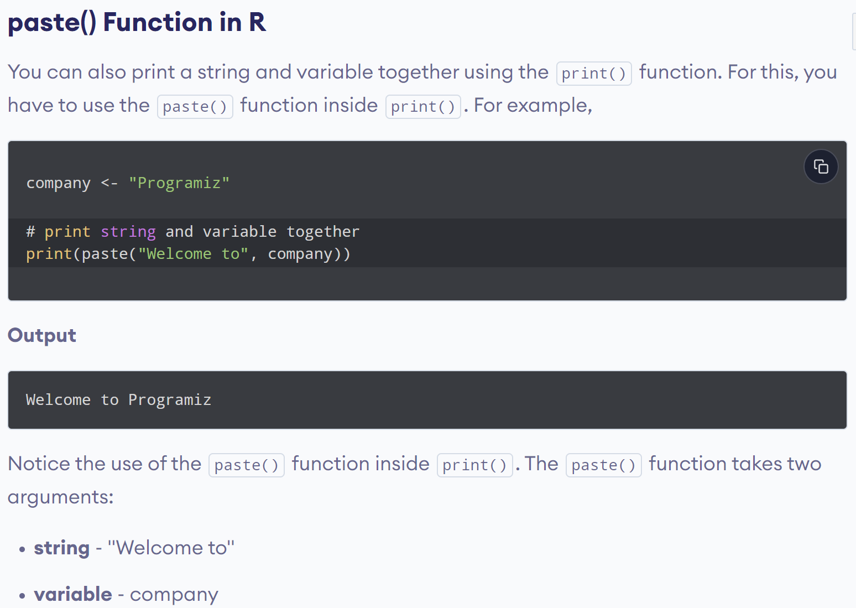
www.lpu.in Lovely Professional University
42

Slide 43
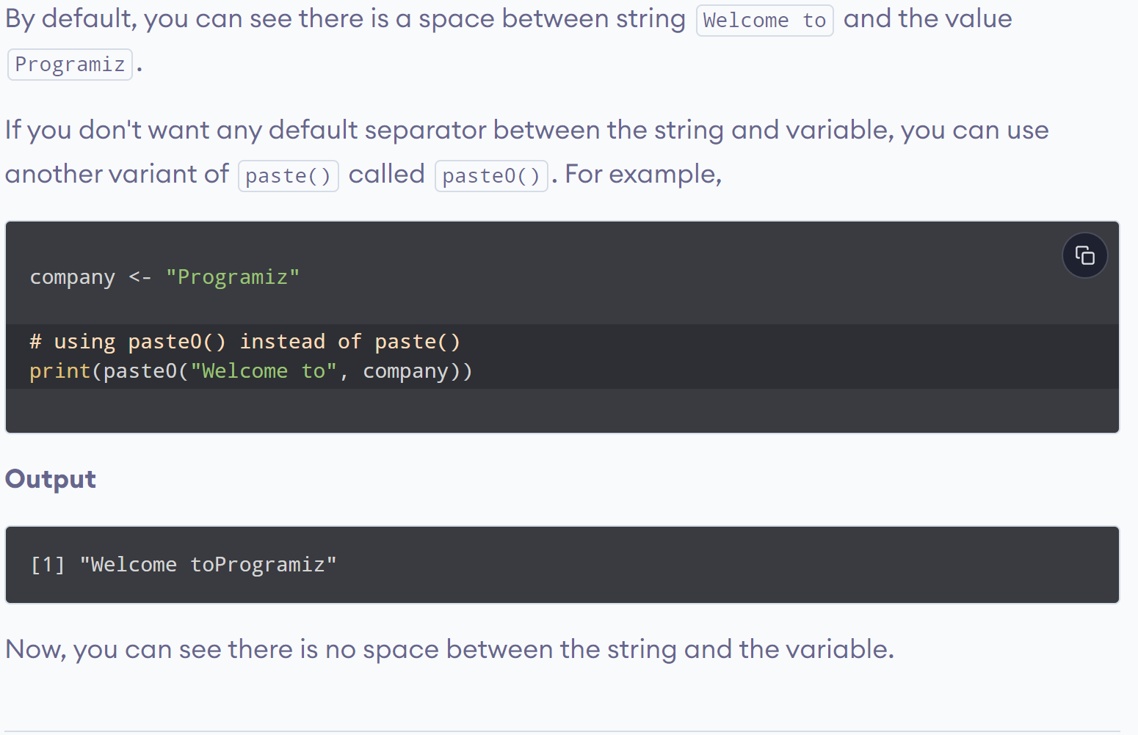
www.lpu.in Lovely Professional University
43

Slide 44
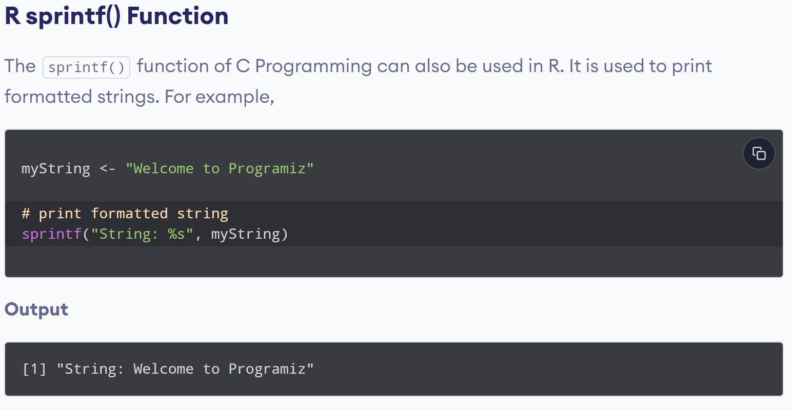
www.lpu.in Lovely Professional University
44

Slide 45
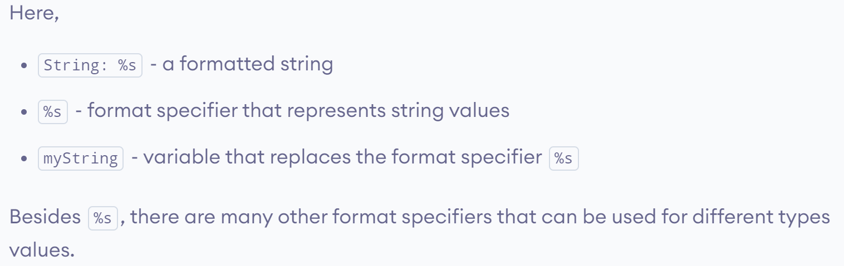
www.lpu.in Lovely Professional University
45

Slide 46
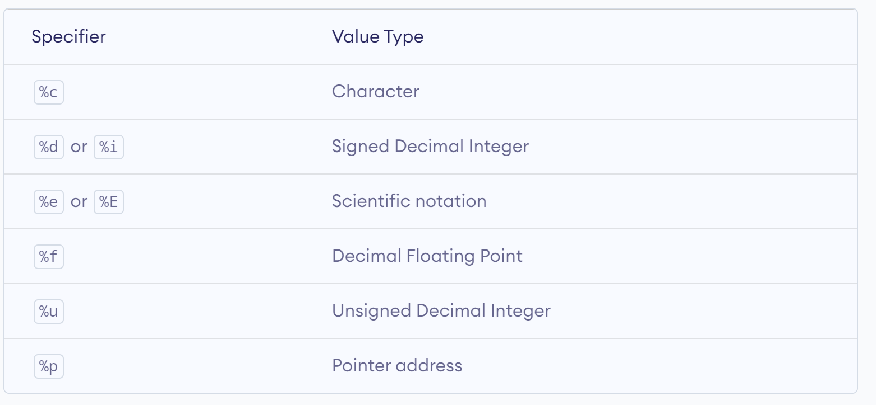
www.lpu.in Lovely Professional University
46

Slide 47
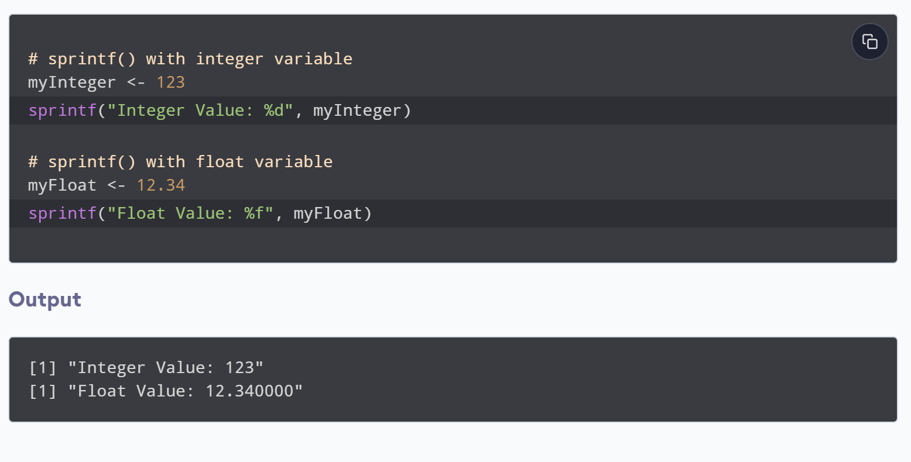
www.lpu.in Lovely Professional University
47

Slide 48
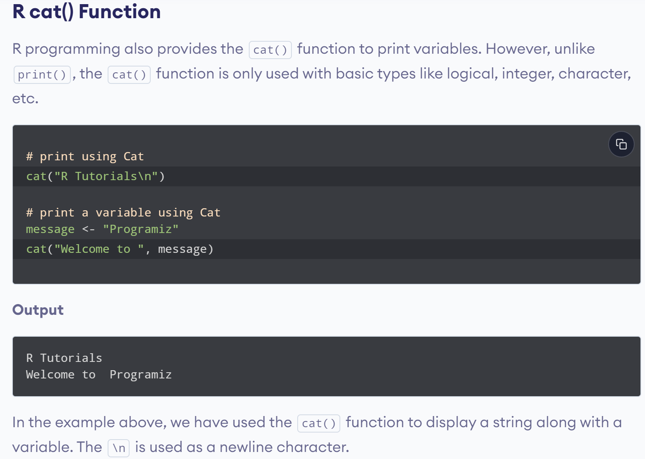
www.lpu.in Lovely Professional University
48

Slide 49
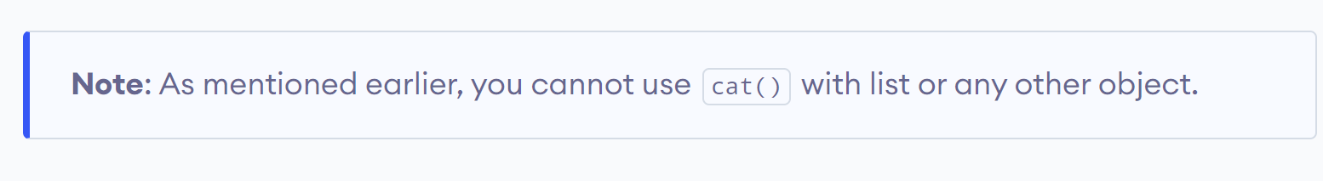
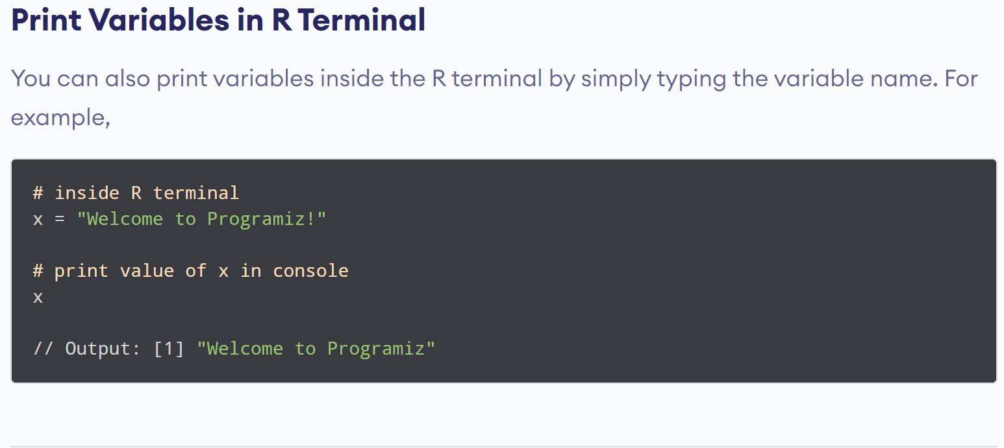
www.lpu.in Lovely Professional University
49

Slide 50

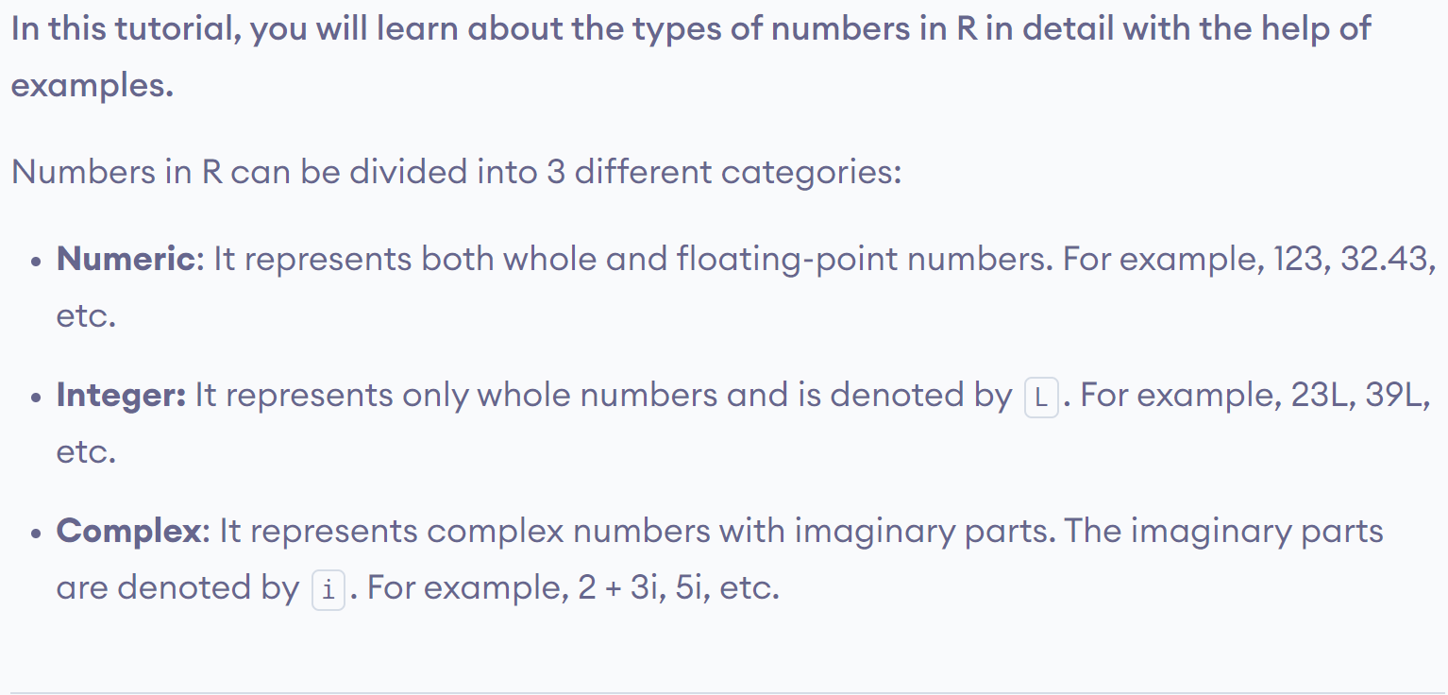
www.lpu.in Lovely Professional University
50

Slide 51

www.lpu.in Lovely Professional University
51

Slide 52


www.lpu.in Lovely Professional University
52

Slide 53

www.lpu.in Lovely Professional University
53

Slide 54

www.lpu.in Lovely Professional University
54

Slide 55
Practice Examples
1. pi*2^3-sqrt(4)
2. abs(12-17*2/3-9)
3. factorial(4)
4. Try to use any of the following , they give you the same answer as they are different form of the same thing.
log(2,10) OR log(2,base=10) Or log10(2)
5. Natural log
Log(2)

Slide 56
6. exp(0.6931472)
7. log10(2)
8. Reverese the logarithm like so:
10^0.30103
9. sin(45*pi/180)

Slide 57
Calling Functions in R
To invoke predefined functions in R, you need to type their names on the R console , followed by comma- separated parameters as arguments within parentheses.
sum(5,26,67,10,56)
Output-164
rep(“hello”,5)
Output-[1] "hello" "hello" "hello" "hello"
[5] "hello"

Slide 58
sqrt(100)
Output-[1] 10
substr(“Example”,2,4)
Output- [1] "xam“
Two R commands can be separated by a semicolon(;) or a newline \n

Slide 59
R – Vectors
1. Vectors in R are the same as the arrays in C language which are used to hold multiple data values of the same type.
2. One major key point is that in R the indexing of the vector will start from ‘1’ and not from ‘0’.
3. Vector is a logical element, which holds the value as well as the magnitude of that value and serves as data structure containers
4. we can easily increase or decrease the container size of a vector to accommodate various data elements

Slide 60
Constructing a vector in R
C(10,20,30,40,50)
Shows the implementation of the c() function to create a vector.
C() function is used to construct a vector. It should be noted that the values or numbers written inside the parenthesis are referred as arguments

Slide 61
A vector can also be created by using the ‘:’operator between the range of numbers
Example:
1:15
(generates numbers from 1 to 15)
Output of the Sequence Operator
[1] 1 2 3 4 5 6 7 8 9 10 11 12 13 14 15

Slide 62
Calculating the sum of a vector
Sum(1:15)
Generates the sum of numbers from 1 to 15
Output:120

Slide 63
Storing and Calculating values in R
R allows you to easily store the intermediate results, so that the stored values can be used later for other calculations
Example:X<-1:15
X
Output:[1] 1 2 3 4 5 6 7 8 9 10 11 12 13 14 15

Slide 64
Now lets create a second variable y , assign the value 30, and add x and y
y<-30
x+y
Output:[1] 31 32 33 34 35 36 37 38 39 40 41 42 43 44 45
Here x+y expression adds the number 30 in the sequence of number 1 to 15.

Slide 65
Combining Text values in R
Example:
a=c(“hello”, “world”)
a
Output: [1] "hello" "world"

Slide 66
Vector with numerical decimals in a sequence
Example: numbers1 <- 1.5:6.5 numbers1
Output:[1] 1.5 2.5 3.5 4.5 5.5 6.5
Example: numbers2 <- 1.5:6.3 numbers2
Output:[1] 1.5 2.5 3.5 4.5 5.5

Slide 67
Vector Length
To find out how many items a vector has, use length() function
Example:
fruits <- c("banana", "apple", "orange")
length(fruits)
Output:[1] 3

Slide 68
Sort a Vector
To sort items in a vector alphabetically or
numerically, use the sort() function:
fruits <- c("banana", "apple", "orange", "mango", "lemon")
numbers <- c(13, 3, 5, 7, 20, 2)
sort(fruits) # Sort a string
sort(numbers) # Sort numbers
Output:
[1] "apple" "banana" "lemon" "mango" "orange" [1] 2 3 5 7 13 20

Slide 69
You can also access multiple elements by referring to different index positions with the c() function:
fruits <- c("banana", "apple", "orange", "mango", "lemon")
# Access first and third item (banana and orange)
fruits[c(1, 3)]
Output:
[1] "banana" "orange"

Slide 70
Change an Item
fruits <- c("banana", "apple", "orange", "mango", "lemon")
# Change "banana" to "pear"
fruits[1] <- "pear"
Fruits
Output:
[1] "pear" "apple" "orange" "mango" "lemon"

Slide 71
Repeat Vectors
To repeat vectors, use the rep() function
Repeat each value:
repeat_each <- rep(c(1,2,3), each = 3)
repeat_each
Output:
[1] 1 1 1 2 2 2 3 3 3

Slide 72
Repeat the sequence of the vector:
repeat_times <- rep(c(1,2,3), times = 3)
repeat_times
Output:
[1] 1 2 3 1 2 3 1 2 3

Slide 73
Entering numerical Items as Data
Add some extra values to create a new(larger) sample
Data1=c(3,5,7,5,3,2,6,8,5,6,9)
Data1
Data2=c(Data1,4,7,10,15)
Data2
Output:[1] 3 5 7 5 3 2 6 8 5 6 9 4 7 10 15

Slide 74
Data1=c(3,5,7,5,3,2,6,8,5,6,9)
Data1
data1=c(14,16,19,Data1)
Data1
Output:[1] 14 16 19 3 5 7 5 3 2 6 8 5 6 9
Now adding Extra values at the beginning has modified the original sample

Slide 75
Entering text item as data
day1=c(“mon”,”tue”,”wed”)
Day1
Output:[1] "mon" "tue" "wed”
If you mix text and numbers, the entire data object becomes a text variable and the numbers are converted to text
Mix=c(data1,day1)
Mix
Output:[1] "14" "16" "19" "3" "5" "7" "5" "3" "2" "6"
[11] "8" "5" "6" "9" "mon" "tue" "wed"

Slide 76
Using scan command for making data
Scan() command do the similar job as that of c()..
Unlike c you don’t need to insert the values in the parentheses but use empty parentheses.
The command then prompt you to enter the data
Once you press the Enter key you will be prompted to enter your data.

Slide 77
Example
>data3=scan()
1: 6 7 8 7 6 3 8 9 10 7
11: 6 9
13:
Read 12 items
> data3
[1] 6 7 8 7 6 3 8 9 10 7 6 9

Slide 78
Entering text as data using scan()
You must tell R to expect that the items typed in are characters , not numbers
To do this you add the what=‘character’ part in the parentheses
Syntax:
scan(what=‘character’)

Slide 79
Example:
> scan(what='character')
1: mon tue wed
4: thu
5:
Read 4 items
[1] "mon" "tue" "wed" "thu"
>

Slide 80
To know all the variables currently available in the workspace we use the ls() function.
print(ls())
Variables can be deleted by using the rm() function.
abc = 15
rm(abc)
All the variables can be deleted by using the rm() and ls() function together.
rm(list=ls())
print(ls())

Slide 81
Getwd() function
The getwd() function is used to display the current working directory of the user.
>getwd()
Creating a vector using seq() function
seq(1,3, by=0.2) #specify step size
Output:[1] 1.0 1.2 1.4 1.6 1.8 2.0 2.2 2.4 2.6 2.8 3.0
seq(1,5, length.out=4) # specify length of vector
Output:[1] 1.000000 2.333333 3.666667 5.000000

Slide 82
Manipulate and Process data in R
A data structure is a specialized format for organizing and data values .
R provides various types of data structures such as vectors and data frames
It also provides various functions to manipulate and process the data stored in different data structures. Eg: subset(), merge() and order

Slide 83
Vector- It is a structure that can contain one or more values of a single type, such as character, number or integer. Vectors are used to represent only one-dimensional data , such as set of digits.
Matrix- It is a two –dimensional vector. You can create a matrix by using matrix() function. This function takes the parameters of numbers to be displayed in either the column or row format. The ncol is used to specify the number of columns , and nrow argument is used to specify the number of rows
Data frames-it is a list of named vectors of the same length. It resembles a spreadsheet or a table in a database with columns and heading for each column. In other words, a data frame can be defined as a matrix in which data is stored in columns having names. Data frames are generally used to represent time series.
List-It is collection of objects that fall under a similar category. A list is not fixed in length and can contain other lists

Slide 84
Various ways to select a part of Vector Object
To create the subsets of data stored in a vector,you can use the subset() function or the [ ] brackets
data1=c(3,5,7,5,3,2,6,8,5,6,9)
> data1
[1] 3 5 7 5 3 2 6 8 5 6 9
> data1[1] # shows the First item
[1] 3
> data1[3] # shows the third item
[1] 7

Slide 85
> data1[1:3]
[1] 3 5 7
> data1[data1>3]
[1] 5 7 5 6 8 5 6 9
> data1[-1] # show all except the first
[1] 5 7 5 3 2 6 8 5 6 9
> data1[data1>3] or subset(data1,data1>3)
[1] 5 7 5 6 8 5 6 9
> data1[data1<5|data1>7]
[1] 3 3 2 8 9

Slide 86
> max(data1)
[1] 9
> min(data1)
[1] 2
> which(data1==max(data1))
[1] 11(eleventh item ie,9 in the vector is the largest)

Slide 87
unmow=c(8,9,7,9,NA)
> sort(unmow,decreasing=T)
[1] 9 9 8 7
>order(unmow)
[1] 3 1 2 4 5
> rank(unmow)
[1] 2.0 3.5 1.0 3.5 5.0

Slide 88
Returning logical values from a vector
>data1=c(3,5,7,5,3,2,6,8,5,6,9)
> data1
[1] 3 5 7 5 3 2 6 8 5 6 9
>which(data1==6)
[1] 7 10
> data1==6
[1] FALSE FALSE FALSE FALSE FALSE FALSE TRUE FALSE FALSE TRUE FALSE

Slide 89
> data1=c(3,5,7,5,3,2,6,8,5,6,9)
> data1
[1] 3 5 7 5 3 2 6 8 5 6 9
> data1>3
[1] FALSE TRUE TRUE TRUE FALSE FALSE TRUE TRUE TRUE TRUE TRUE
> data1<5
[1] TRUE FALSE FALSE FALSE TRUE TRUE FALSE FALSE FALSE FALSE FALSE
> data1>2 & data1<5
[1] TRUE FALSE FALSE FALSE TRUE FALSE FALSE FALSE FALSE FALSE FALSE

Slide 90
Create a subset of texts after removing the word “one” using subset() function
Example:
> t=c("one","one","two","three","four","two")
> t
[1] "one" "one" "two" "three" "four" "two"
> subset(t,t!="one")
[1] "two" "three" "four" "two"
Or
> t[t!="one"]
[1] "two" "three" "four" "two"

Slide 91
Assigning values using vectors
An important difference between the subset() function and the square brackets is that by using square brackets you can assign the values to elements , however you can not do that by using the subset() function
Example:
data1=c(3,5,7,5,3,2,6,8,5,6,9)
> data1
[1] 3 5 7 5 3 2 6 8 5 6 9
data1[data1<3]=7 # to replace the number less than 3 with new number 7
> data1
[1] 3 5 7 5 3 7 6 8 5 6 9

Slide 92
> subset(data1,data1<3)=7
Error in subset(data1, data1 < 3) = 7 : could not find function "subset<-"

Slide 93
The following operators help you to form subsets of data in R
$-the dollar operator is used to select a single element of data . When this operator is used with a data frame, the result is always a vector
[[- The double square brackets operator is used to return a single element. It provides the flexibility of referring the elements by their position rather than by name. Generally, it is used to represent the data stored in data frames and lists
[ ] -the single square brackets operator is used to extract multiple elements of data

Slide 94
Data Frames
Data Frames are data displayed in a format as a table.
Data Frames can have different types of data inside it.
While the first column can be character,
the second and third can be numeric or logical.
However, each column should have the same type of data.
Use the data.frame() function to create a data frame:

Slide 95
> data_frame=data.frame(Training = c("Strength", "Stamina", "Other"),
+ Pulse = c(100, 150, 120),
+ Duration = c(60, 30, 45)
+ )
> data_frame
Training Pulse Duration
1 Strength 100 60
2 Stamina 150 30
3 Other 120 45

Slide 96
> Data_Frame[1]
Training
1 Strength
2 Stamina
3 Other
> Data_Frame[["Training"]]
[1] "Strength" "Stamina" "Other"
>
> Data_Frame$Training
[1] "Strength" "Stamina" "Other"

Slide 97
Add a new row
rbind() function
> # Add a new row
>New_row_DF <- rbind(Data_Frame, c("Strength", 110, 110))
> # Print the new row
> New_row_DF
Training Pulse Duration
1 Strength 100 60
2 Stamina 150 30
3 Other 120 45
4 Strength 110 110

Slide 98
Add Columns
Use the cbind() function to add new columns in a
Data Frame
> New_col_DF <- cbind(Data_Frame, Steps = c(1000, 6000, 2000))
> New_col_DF
Training Pulse Duration Steps
1 Strength 100 60 1000
2 Stamina 150 30 6000
3 Other 120 45 2000

Slide 99
Number of Rows and Columns
> dim(Data_Frame) #dimensions
[1] 3 3
You can also use the ncol() function to find the number of columns and nrow() to find the number of rows
> ncol(Data_Frame)
[1] 3
> nrow(Data_Frame)
[1] 3

